Slide 1

Recover More
with
AlphaZyme D300
July 2021

Slide 2
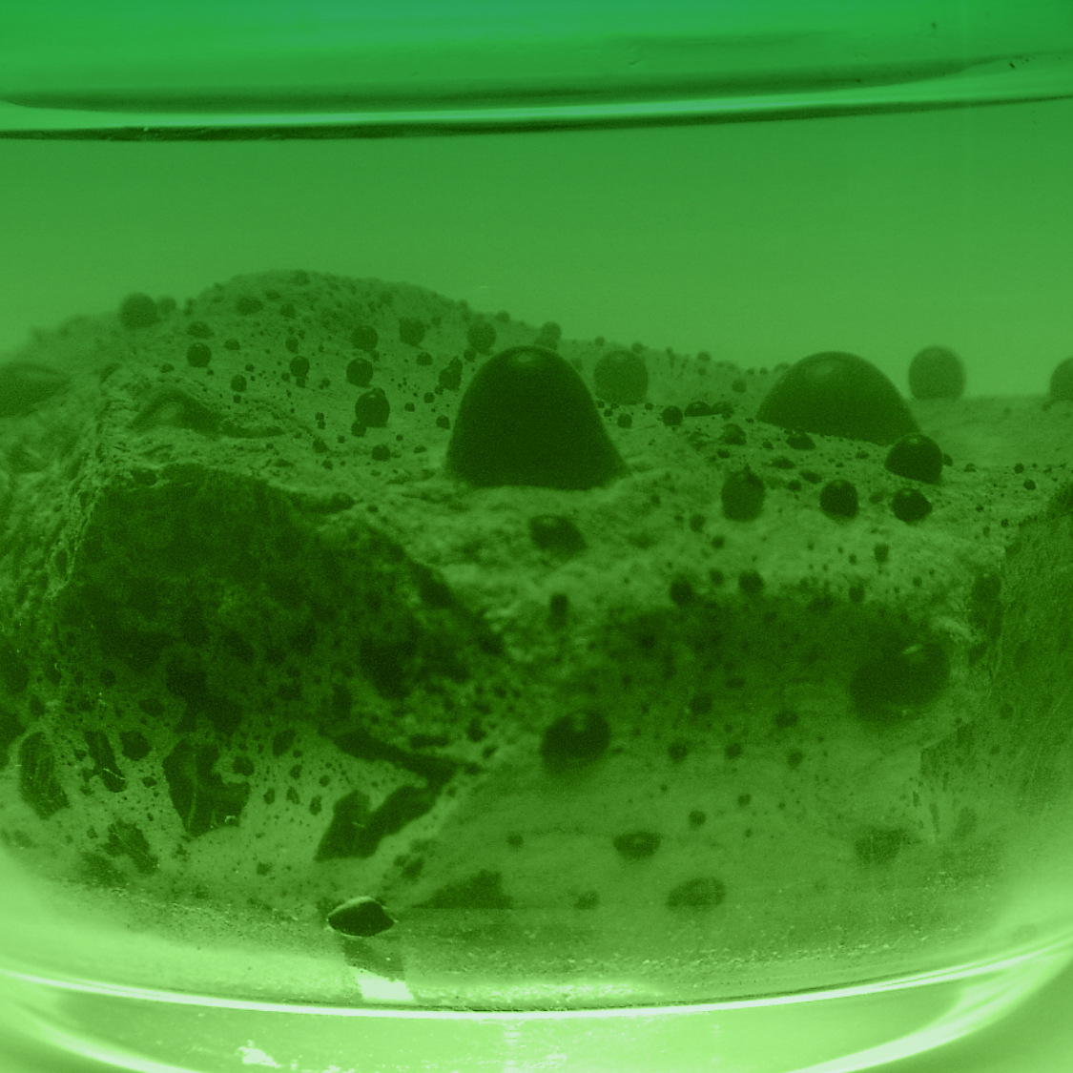
Who is Complus Trading?
Complus Trading is an innovative organization representing the product AlphaZyme, a proven technology that has successfully treated over one thousand wells worldwide.
AlphaZyme has shown great success increasing oil mobility and recovery in both primary and secondary production phases as well as waterfloods.
AlphaZyme is a proven product utilizing relatively unfamiliar technology in the form of a true oil-releasing catalyst, non-living enzyme.
Complus Trading has developed new methodologies which has greatly enhanced the product’s applicability in the upstream oil-recovery segments, to include unconventional assets. Additionally, we have begun to successfully enter new markets such as midstream separation, remediation, and storage cleaning.

Slide 3

Complus Trading is proud to be producer of AlphaZyme®, the most experienced and successful enzyme-EOR product available for enhanced oil recovery.
AlphaZyme® is proud to be an American-made product, manufactured in Houston, Texas.

Slide 4
Value Proposition for Oil Recovery
Benefits
Execution
Complus Trading Solutions provides sustainable increases in oil production with methodologies utilizing AlphaZyme® technology
Recover More OOIP
Help to release trapped oil and enhance oil’s mobility to produce
Production Improvement
Reach unrecoverable oil through tight rock with time, water +AZ
Aid oil mobility through formation without impact to crude, no added emulsions, effective for both heavy and light oil
Flow Assurance
Alleviate blockages; mobilizes paraffin to production, not solving it (not inhibitor)
Life of Well Improvement
Oil’s improved mobility sustains profitability and delay P&A costs
Complus Trading Solutions works together with clients to plan and execute field-specific projects
Near Wellbore Treatments
Advantageous of selected wells for huff-n-puff stimulation or similar operation
Existing Injectors (with know channels of communication)
Distributes product through the field, improving sweep efficiency and aiding oil’s mobility
Reclaimed AlphaZyme®-Water
Recovered post treatment, if feasible, utilized for additional stimulation operations in the field, helping secure economic success at a low cost
4

Slide 5
Value Proposition for Oil Recovery
Risk
Return on Investment
Complus Trading Solutions recommended methods and operations, utilizing the technology AlphaZyme®, provides little operational risk
No harm to people or environment
No damage to equipment or systems
No negative impacts to reservoir
No impact to the hydrocarbon product
Complus Trading Solutions when strategically treating wells from a field-view, yield incremental oil that present significant ROI
Incremental oil typically pays for treatment in 30-90 days
Water injection communication time to producers must be taken into account – including accurate measurements
Anticipated ROI equal to 2-3x investment or more
Ability to have established historical data production and accurate measurements are key
Benefit of environmentally friendly solution
Better for assets and reservoirs
Improvement to crude quality / value - pure separation, no chemical bi-products
5

Slide 6

Technology Background

Slide 7
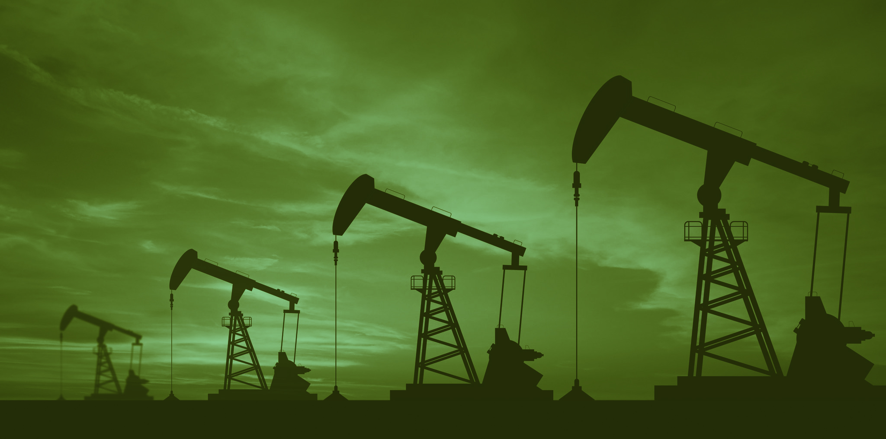
Vision for a Disruptive Technology
Dr. Philip Lau obtained his PhD in Chemical Engineering from Texas A&M University and began his career working with Dow Chemical.
Dow Career
  10-year tenure serving as Dow Research Group Leader
  Managed 300 technical staff, 60 of which were PhD’s
  His group developed ASP technologies still utilized today
  Dr. Lau personally commercialized 12-patent technologies during the same period
Only two promotions away from achieving the honour of Dow Fellow, Dr. Lau resigned from his role to fulfil his vision to create a new technology – the first of its kind – a non-living oil-releasing catalyst.
Notes:
3 Important factors we have learned need to bee considered when introducing of AlphaZyme product into a field / wells.

Slide 8
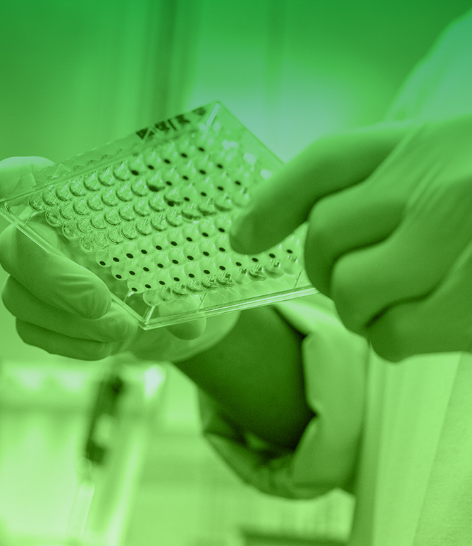
What is
AlphaZyme®
?
AlphaZyme is the evolution of microbe technology for the purpose of EOR.
A natural biological catalyst designed to increase oil mobility and improve relative-permeability, helping to recover more OOIP.
A 100% biodegradable solution that is more powerful and longer lasting in the reservoir as a result of its catalytic functionality.
Notes:
AlphaZyme is not a microbe solution i.e. the “bug” solution coined back in the ‘90’s – it’s completely different
AlphaZyme is the evolution of microbe technology – one of mother nature’s secret weapons

Slide 9
Unaffected by adverse well conditions such as:
Temperature
pH
Salinity
Radioactive Isotopes
NORM
Sulfur
Hydrogen Sulfide content
Paraffin
Notes:
AZ is not susceptible to many conditions and challenges associated to other oil recovery solutions

Slide 10
IOR / EOR
Chemistry
Biology
Physics
Fracturing
Hot oils
Acid and caustic
ASP, polymers
Microbes – Living
Enzymes – Non-living
Water-flooding
Steam -injection
Microwave
Radio Frequency
Nano Technology
Notes:
There are three categories associated to improve oil recovery methods: Chemistry, Biology and Physics
Today’s meeting is about the natural solution Mother Nature invented – far more efficient oil recovery tool than either chemistry or physics

Slide 11
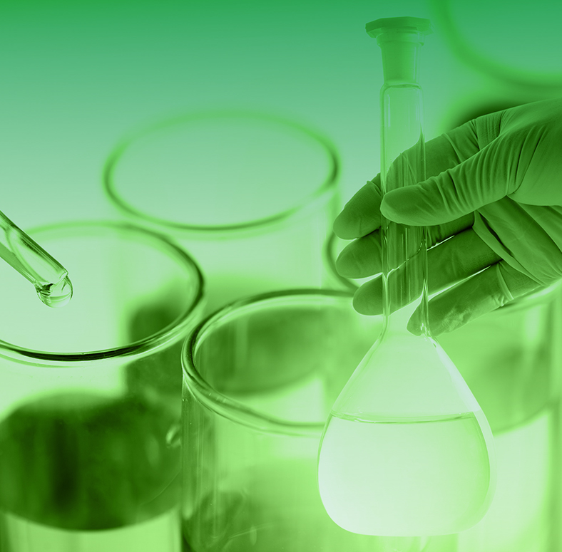
Enzyme-EOR ?
Living Organism
Microbe – single-cell organisms so tiny that millions can fit into the eye of a needle. Oil-Eating microbe converts oil into carbon dioxide and water.
Non-Living Organism
Enzyme – substance produced by a living organism that acts as a catalyst to bring about specific biochemical reaction.
True Biological Catalyst
Catalyst – substance that increases the rate of a chemical reaction without itself undergoing any permanent chemical change.
Notes:
AlphaZyme is a non-living product
As a true-catalyst, AZ is inert to everything except hydrocarbons
The product is able to repeat its function repeatedly over time without losing efficacy

Slide 12
Solution Comparison
AlphaZyme® surpasses traditional recovery solutions in nearly every feature
Feature | Microbes | Surfactant | Polymer | Thermal | AlphaZyme®
Category | Biology | Chemistry | Chemistry | Physics | Biology
Description | Living bacteria to break up the oil | Reduces IFT | Large sized molecules to push oil | Increases mobility through heat | Millions of interactions per seconds to free oil
Market acceptance
Applied as Conventional EOR Solution
Applied as an Unconventional EOR Solution
Provides effective physical mobilization of oil
Positive impact to IFT, Contact Angle, Capillary
Retains Efficacy over long distances
Minimal treatments required for efficacy
Non-consumable and Reusable solution
Ease of use, no special equipment required
No risk to equipment or reservoir
Environmentally friendly and non-harmful
These features directly affect capex and opex
= High = Medium = Low
12

Slide 13
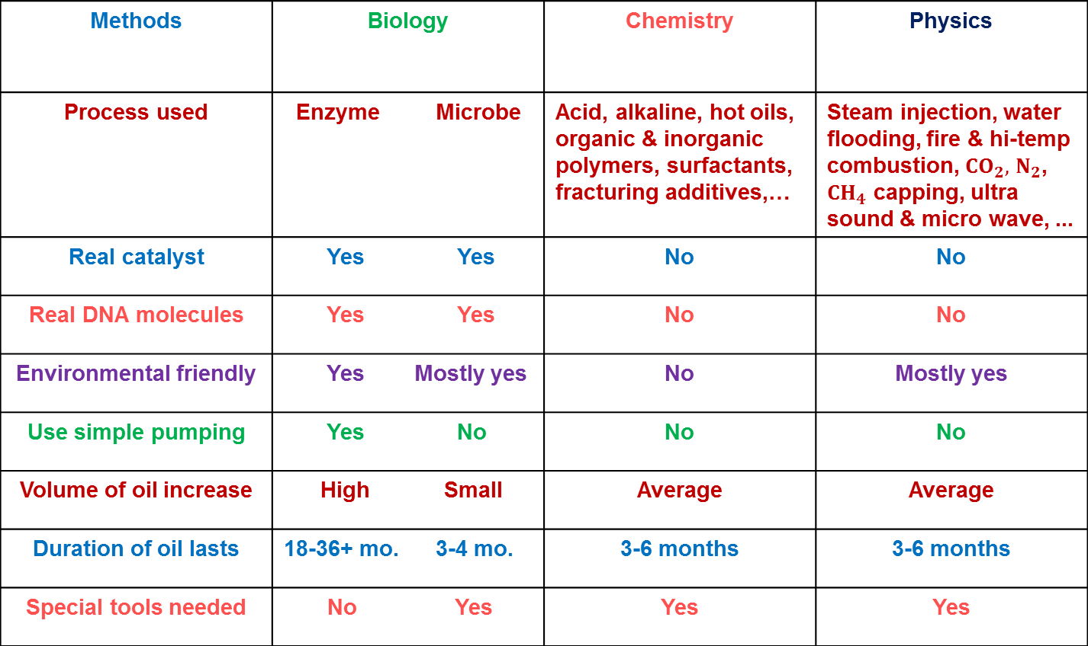
Things to Consider when Choosing EOR Technologies
Methods | Biology | Chemistry | Physics
Process used | Enzyme Microbe | Acid, alkaline, hot oils, organic & inorganic polymers, surfactants, fracturing additives,…
Real catalyst | Yes Yes | No | No
Real DNA molecules | Yes Yes | No | No
Environmental friendly | Yes Mostly yes | No | Mostly yes
Use simple pumping | Yes No | No | No
Volume of oil increase | High Small | Average | Average
Duration of oil lasts | 18-36+ mo. 3-4 mo. | 3-6 months | 3-6 months
Special tools needed | No Yes | Yes | Yes
Non-living
Living

Slide 14
How does AlphaZyme work?

Slide 15
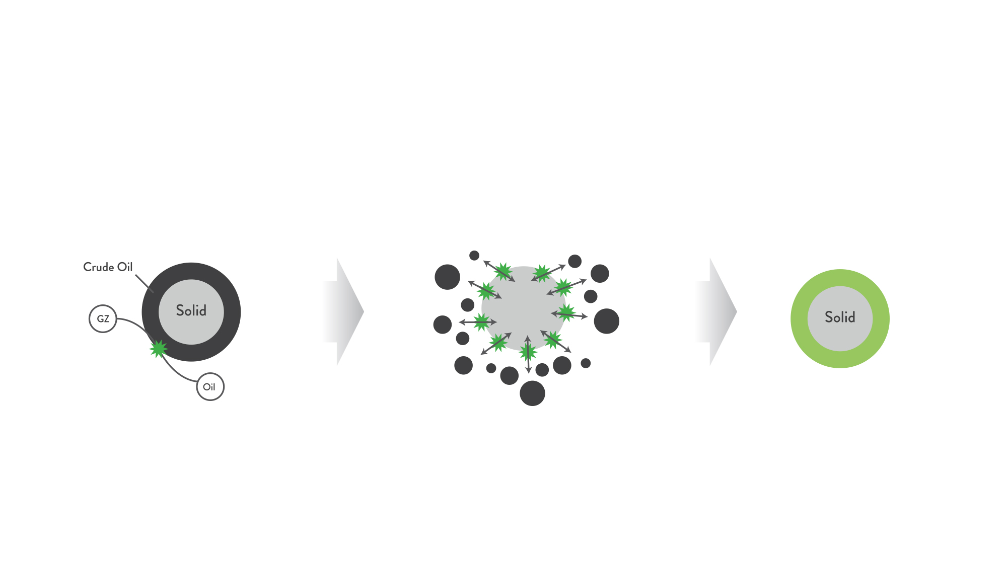
Oil releasing process with AlphaZyme®
H+
Active Site
OH-
AlphaZyme® physically releases oil from solid, relieving IFT, improving contact angle and alleviating capillary pressures
AlphaZyme® molecule interacting with crude oil attached to solid
Oil-wetted surface changed to a water-AlphaZyme®-wetted surface
Notes:
AZ is a inert water-soluble molecule that must come into physical contact with oil to begin its catalytic function. AZ reacts with hydrocarbons at a rate of millions reactions per second performing one single function, to release microscopic droplets of oil. The droplets are released from the surface of rock, changing wettability and enhancing oil’s mobility throughout the formation.

Slide 16
Technology & Mechanism
AlphaZyme® is the evolution of microbe-biology technology for the purpose of improved oil-recovery. The product is engineered through a proprietary DNA-transfer process that involves impregnating a high-protein nutrient solution with selective DNA of oil-digesting microbes. This process results in an inert and water-soluble protein DNA-molecule, a non-living biological enzyme, specifically designed to act as an oil-releasing catalyst, capable of producing millions of reactions per second.
The enzymatic function of the catalyst is strictly limited to its interaction with hydrocarbons. As a true-catalyst, AlphaZyme® has the ability to perform its function repeatedly as a non-consumable agent, without loss of efficacy over time. The mechanism involves three components: H⁺, OH⁻, and an “active site”, which represents the proprietary DNA component. The H⁺ and OH⁻ components form a polar part and the active site forms a non-ionic part. Upon contact with a hydrocarbon the non-ionic part allows the enzyme to penetrate the hydrocarbon, whereby the polar H⁺ and OH⁻ components work to release microscopic droplets of oil.
Notes:
AlphaZyme is a non-living product
As a true-catalyst, AZ is inert to everything except hydrocarbons
The product is able to repeat its function repeatedly over time without losing efficacy

Slide 17
Technology & Mechanism, con’t
The result of this unique behavior is a clean release of oil by relieving interfacial tension, improving contact angle and alleviating capillary pressures. This process is continuous over time and produces no byproducts of any kind. The hydrocarbon’s mobility is improved without impacting the hydrocarbon chain or changing viscosity. AlphaZyme’s® enzymatic catalyst function is capable of providing production impacts that have been measured in the field for durations in excess of 12 months after a single treatment.
AlphaZyme® is the industry’s first non-consumable and reusable downhole oil-recovery
technology, an environmentally-friendly solution.
Notes:
AlphaZyme is a non-living product
As a true-catalyst, AZ is inert to everything except hydrocarbons
The product is able to repeat its function repeatedly over time without losing efficacy

Slide 18
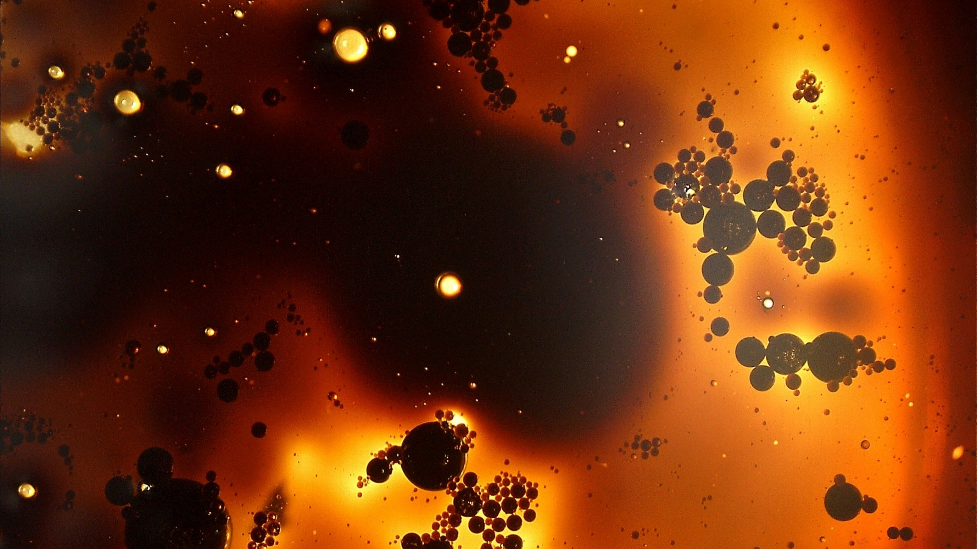
Notes:
Under the microscope you can see the microscopic droplets of oil in the form of a grey or dark cloud. As the droplets travel up towards surface they rejoin together forming the larger droplets you see, without any impact to viscosity or breaking the hydrocarbons chain. It’s a completely clean release of oil that takes place.

Slide 19
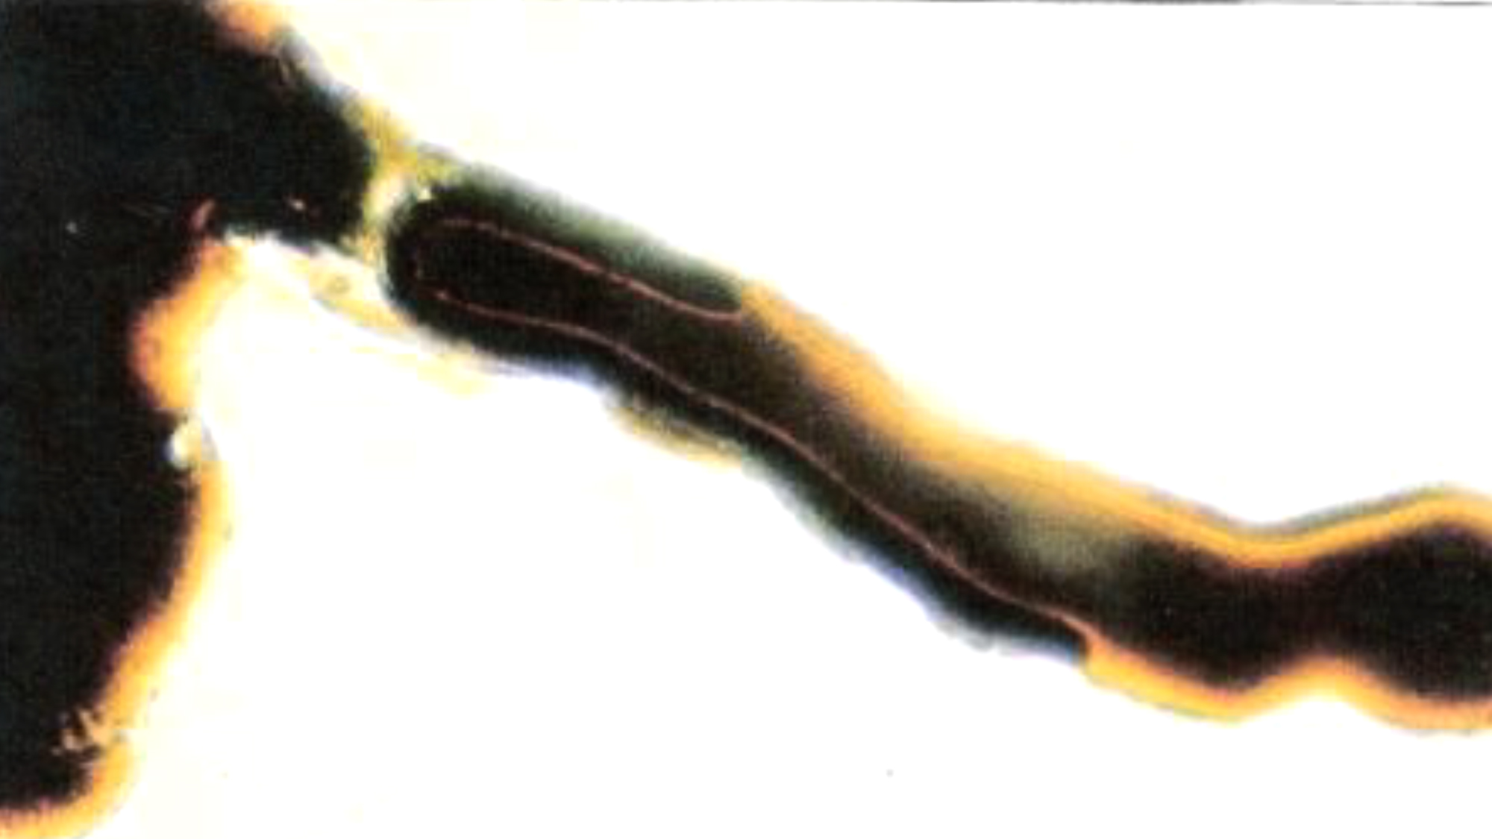
Oil in formation
AlphaZyme at work with
heavy oil in formation
AlphaZyme changing wettability, changing oil mobility
Rock framework
Data Source: Qing-xian Feng, SPE 107128, Feb. 2009.
Notes:
The AZ shown here is not “attached the rock”. The AZ has mobilized the oil and the oil is moving through the rock formation. AZ appears near the rock as it is the heavier component of the oil-water solution migrating through rock.

Slide 20
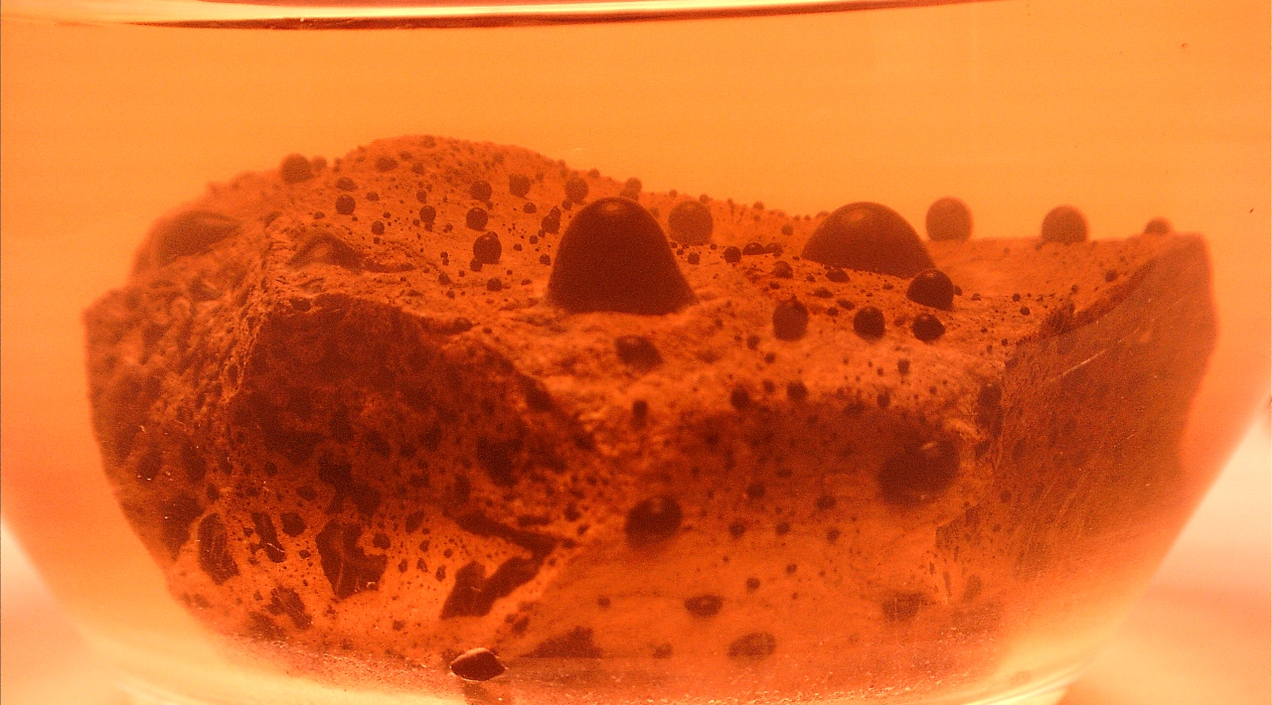
Notes:
This is a core. The core is hard and you cannot see the oil inside it. But when submerged in AZ-water, the oil is being released within the core and as it seeks the path of least resistance to get out, its goes to common areas where we see the oil bulging out as a result. Ultimately, the capillary pressure will be overcome and the oil will release from the rock.

Slide 21
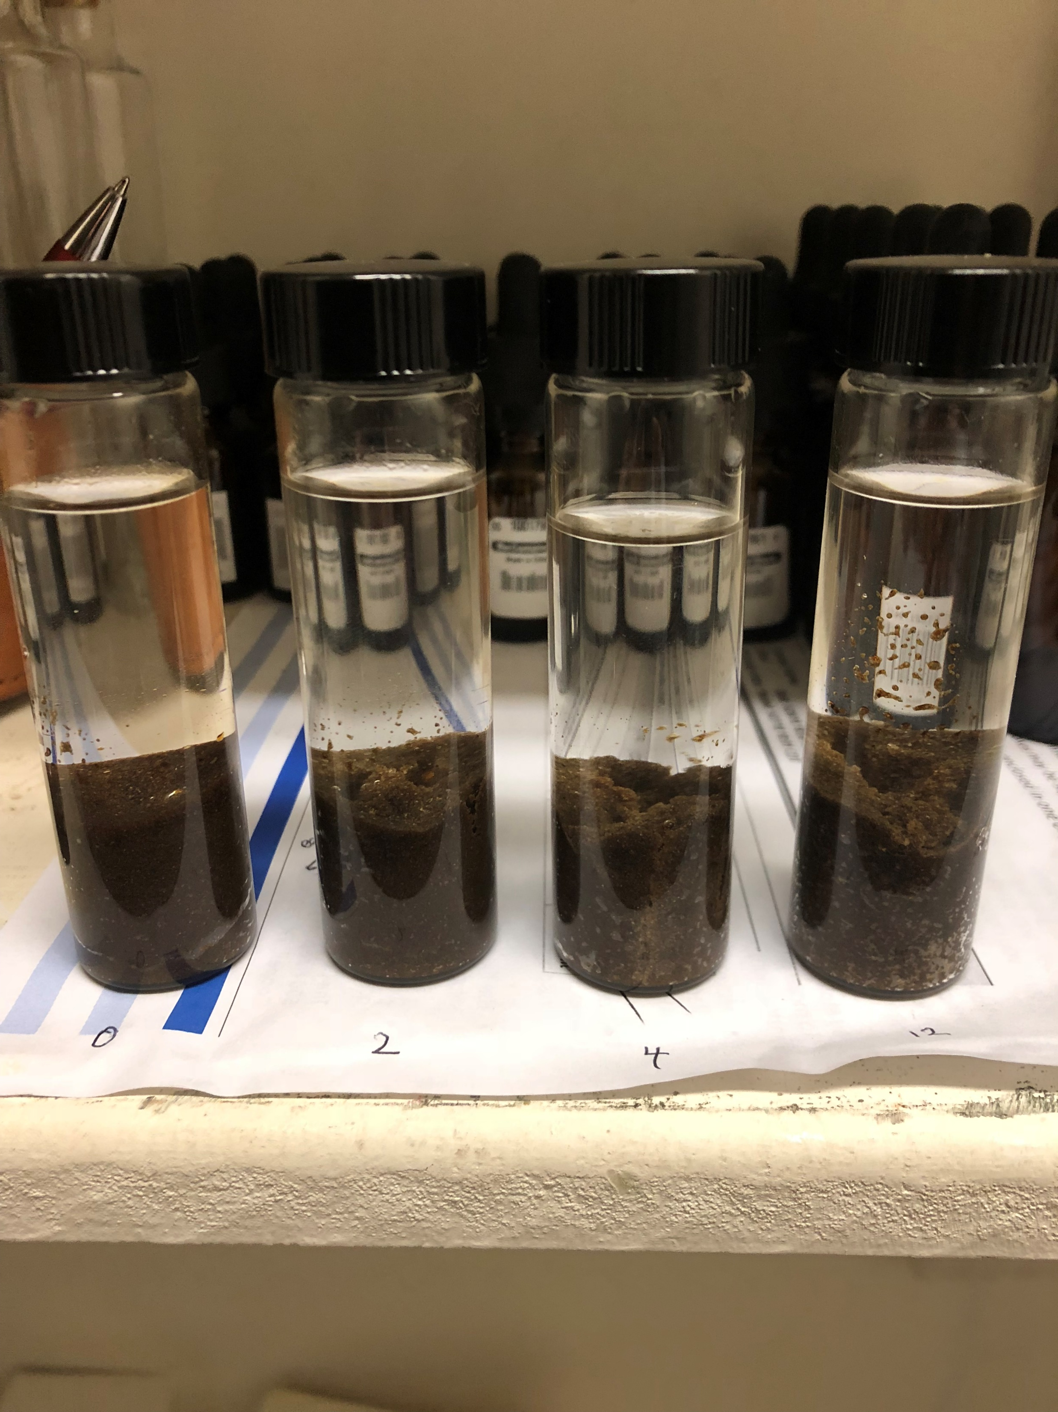
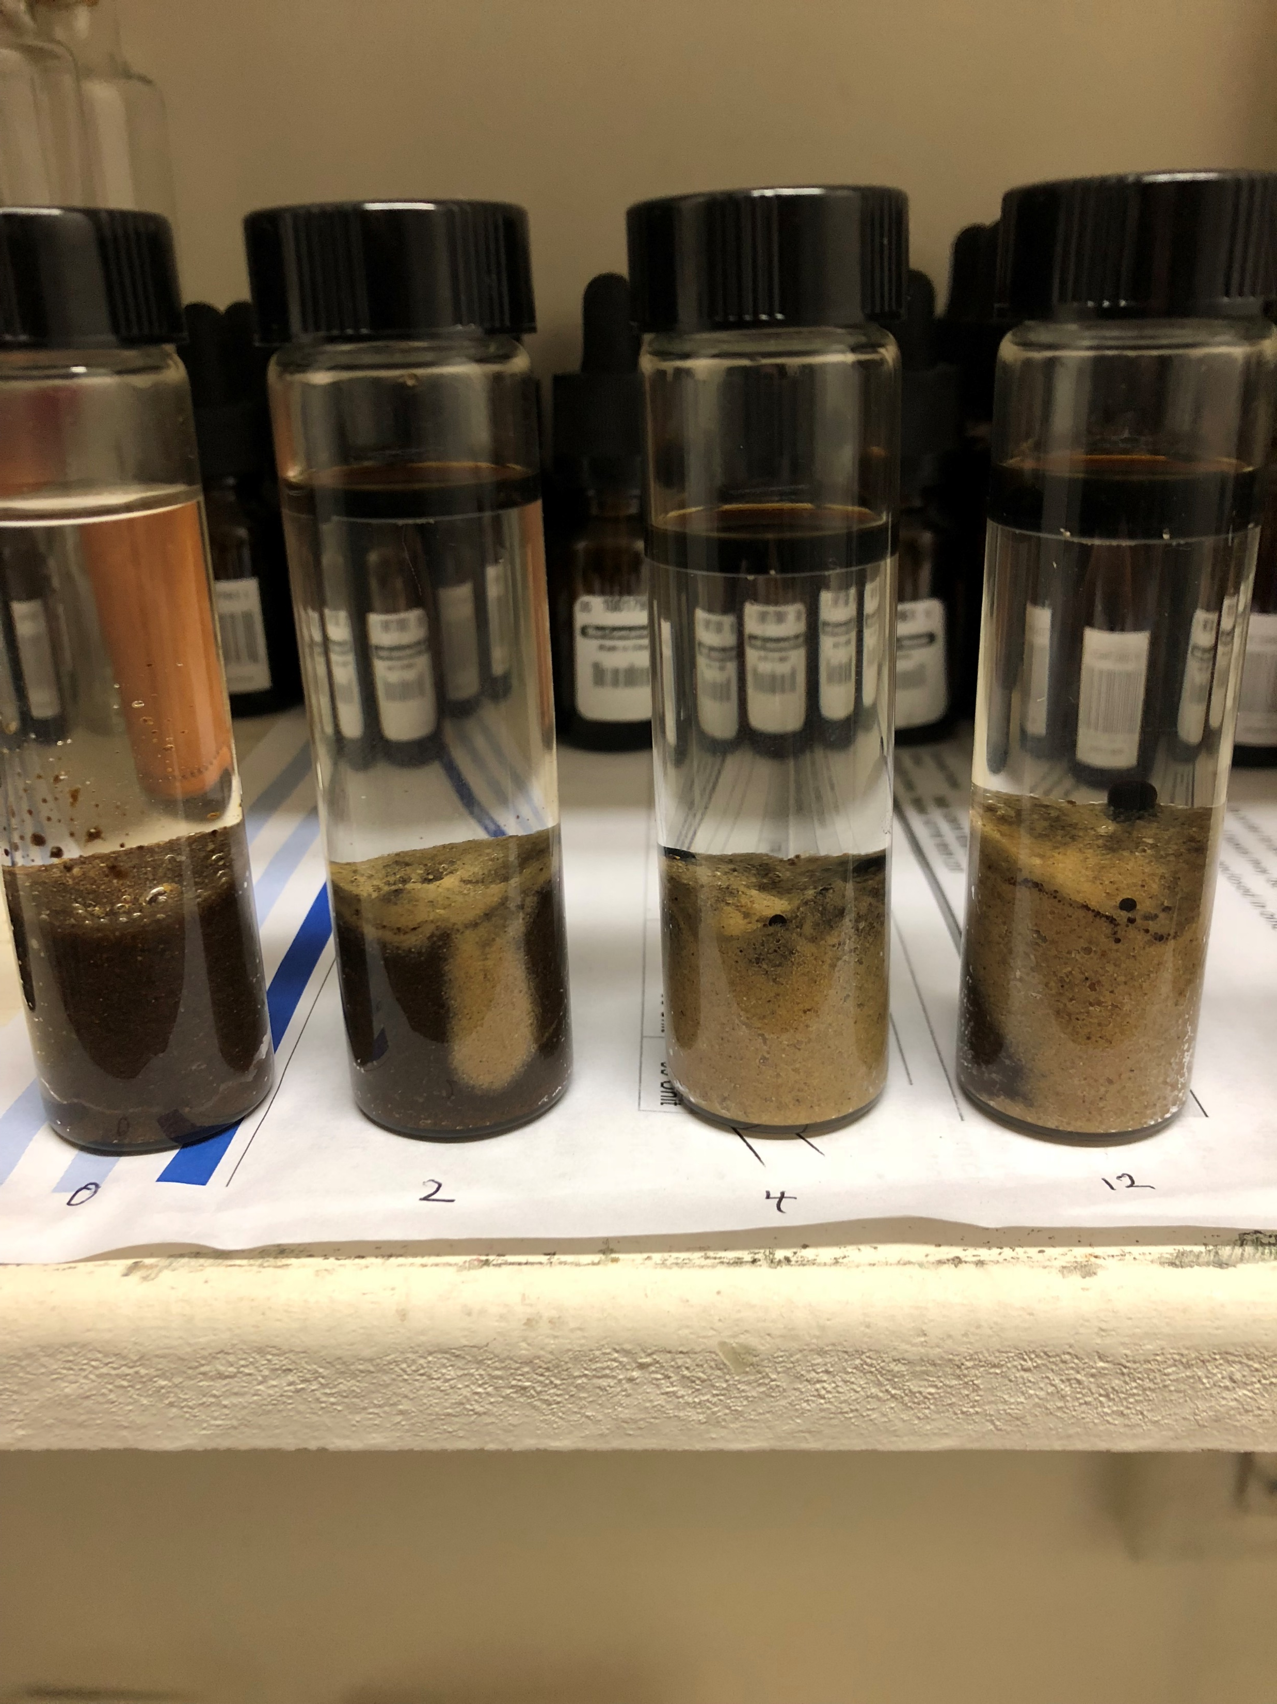
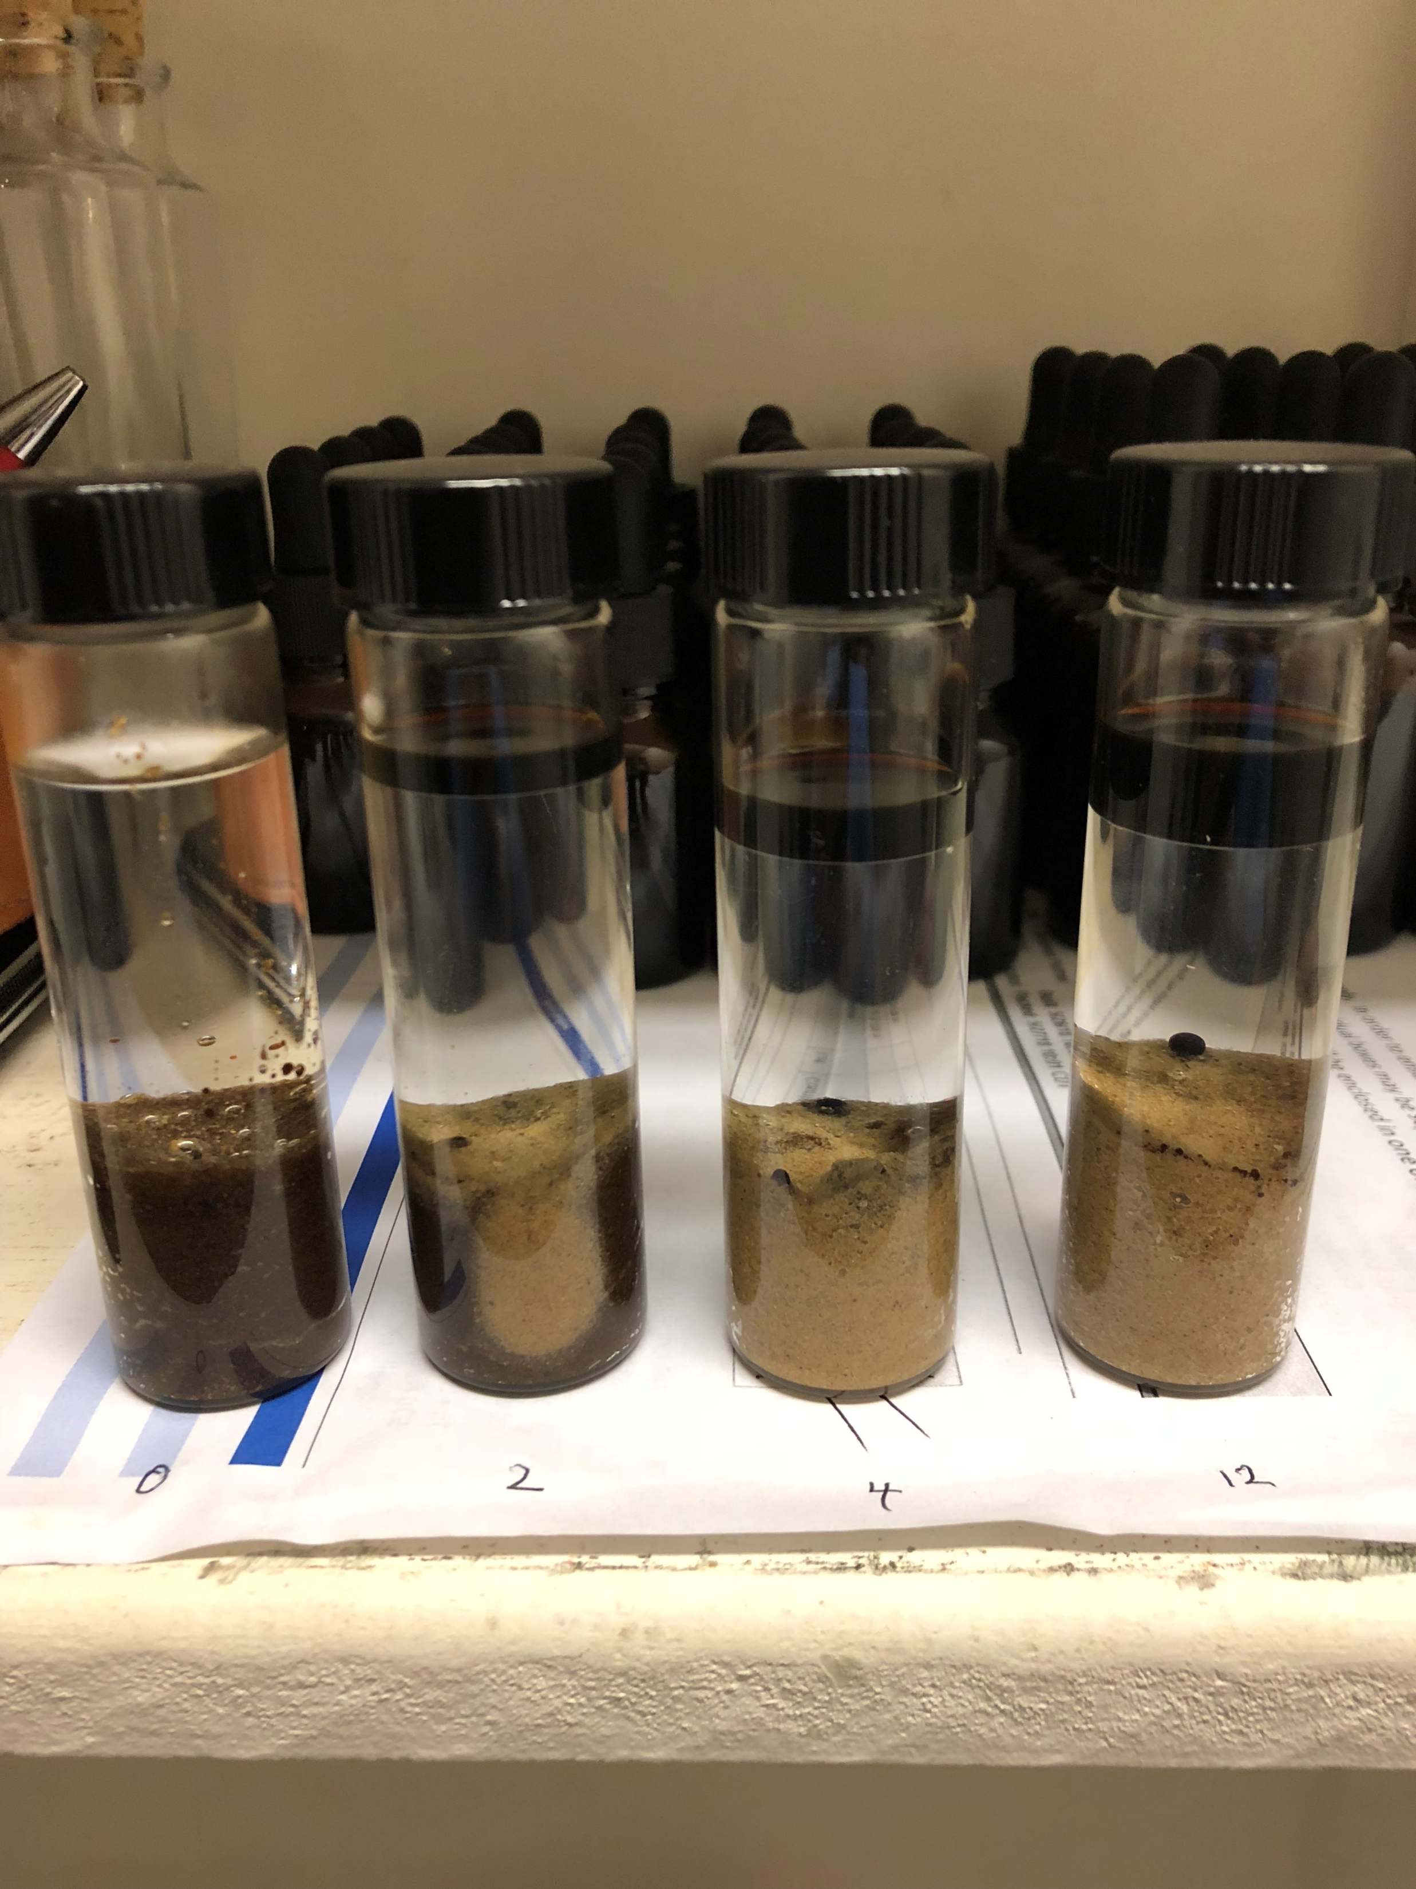
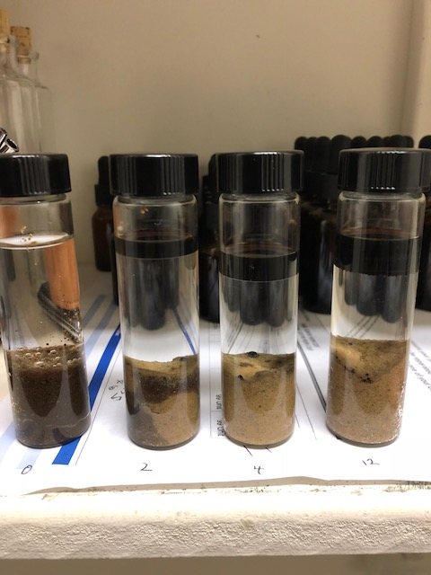
AlphaZyme, a catalyst at work
0 hours
24 hours
48 hours
72 hours
Without any agitation, AZ cleanly releases oil from the surface of rock.
Notes:
These samples are very similar to the samples you have today. Permian dead-oil mixed with sand, between 34-38 API. The samples photographed from left to right received 0,2,4,12 drops of AZ added to the sample. And the results are as shown over 24-hour, 48 and 72-hours, respectfully. Without agitation, AZ cleanly released the oil. The water is like a highway, it finds the path of least resistance down into the oil-sand mixture. And as AZ travels through diffusion in the water it interacts with oil and releases it. The oil droplets then use the water again as a highway to travel out the path of least resistance.

Slide 22
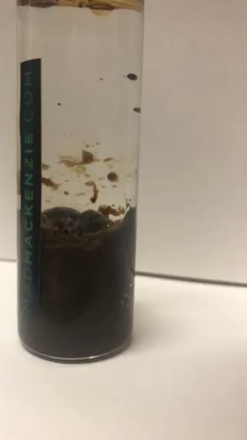
As AlphaZyme reaches the oil / sand mixture, oil immediately releases from the substrate.
Gravity then does its job; the pure oil separates and floats to surface while sediment is left behind on the surface floor.
Click above to watch embedded video.

Slide 23
Recover More OOIP
AZ is the industry’s first non-consumable and re-usable downhole recovery solution, proven to Recover More OOIP
Improving Oil Migration
Summary of
AZ’s impact to IFT and contact angle aid oil’s mobility to travel through formation more efficiently, requiring less pressure drive
AlphaZyme®
Benefits
Heavy Oil Production
Mobilize heavy oil more efficiently than traditional chems and does not impact the hydrocarbon chain or cause emulsions
Paraffin Mitigation
AZ is not a solvent, however as a result of its behavior AZ is able alleviate blockages to help mobilize paraffin with the residual oils it encounters
Notes:
Main features & benefits of AZ

Slide 24
Complus Trading
Market-Entry

Slide 25
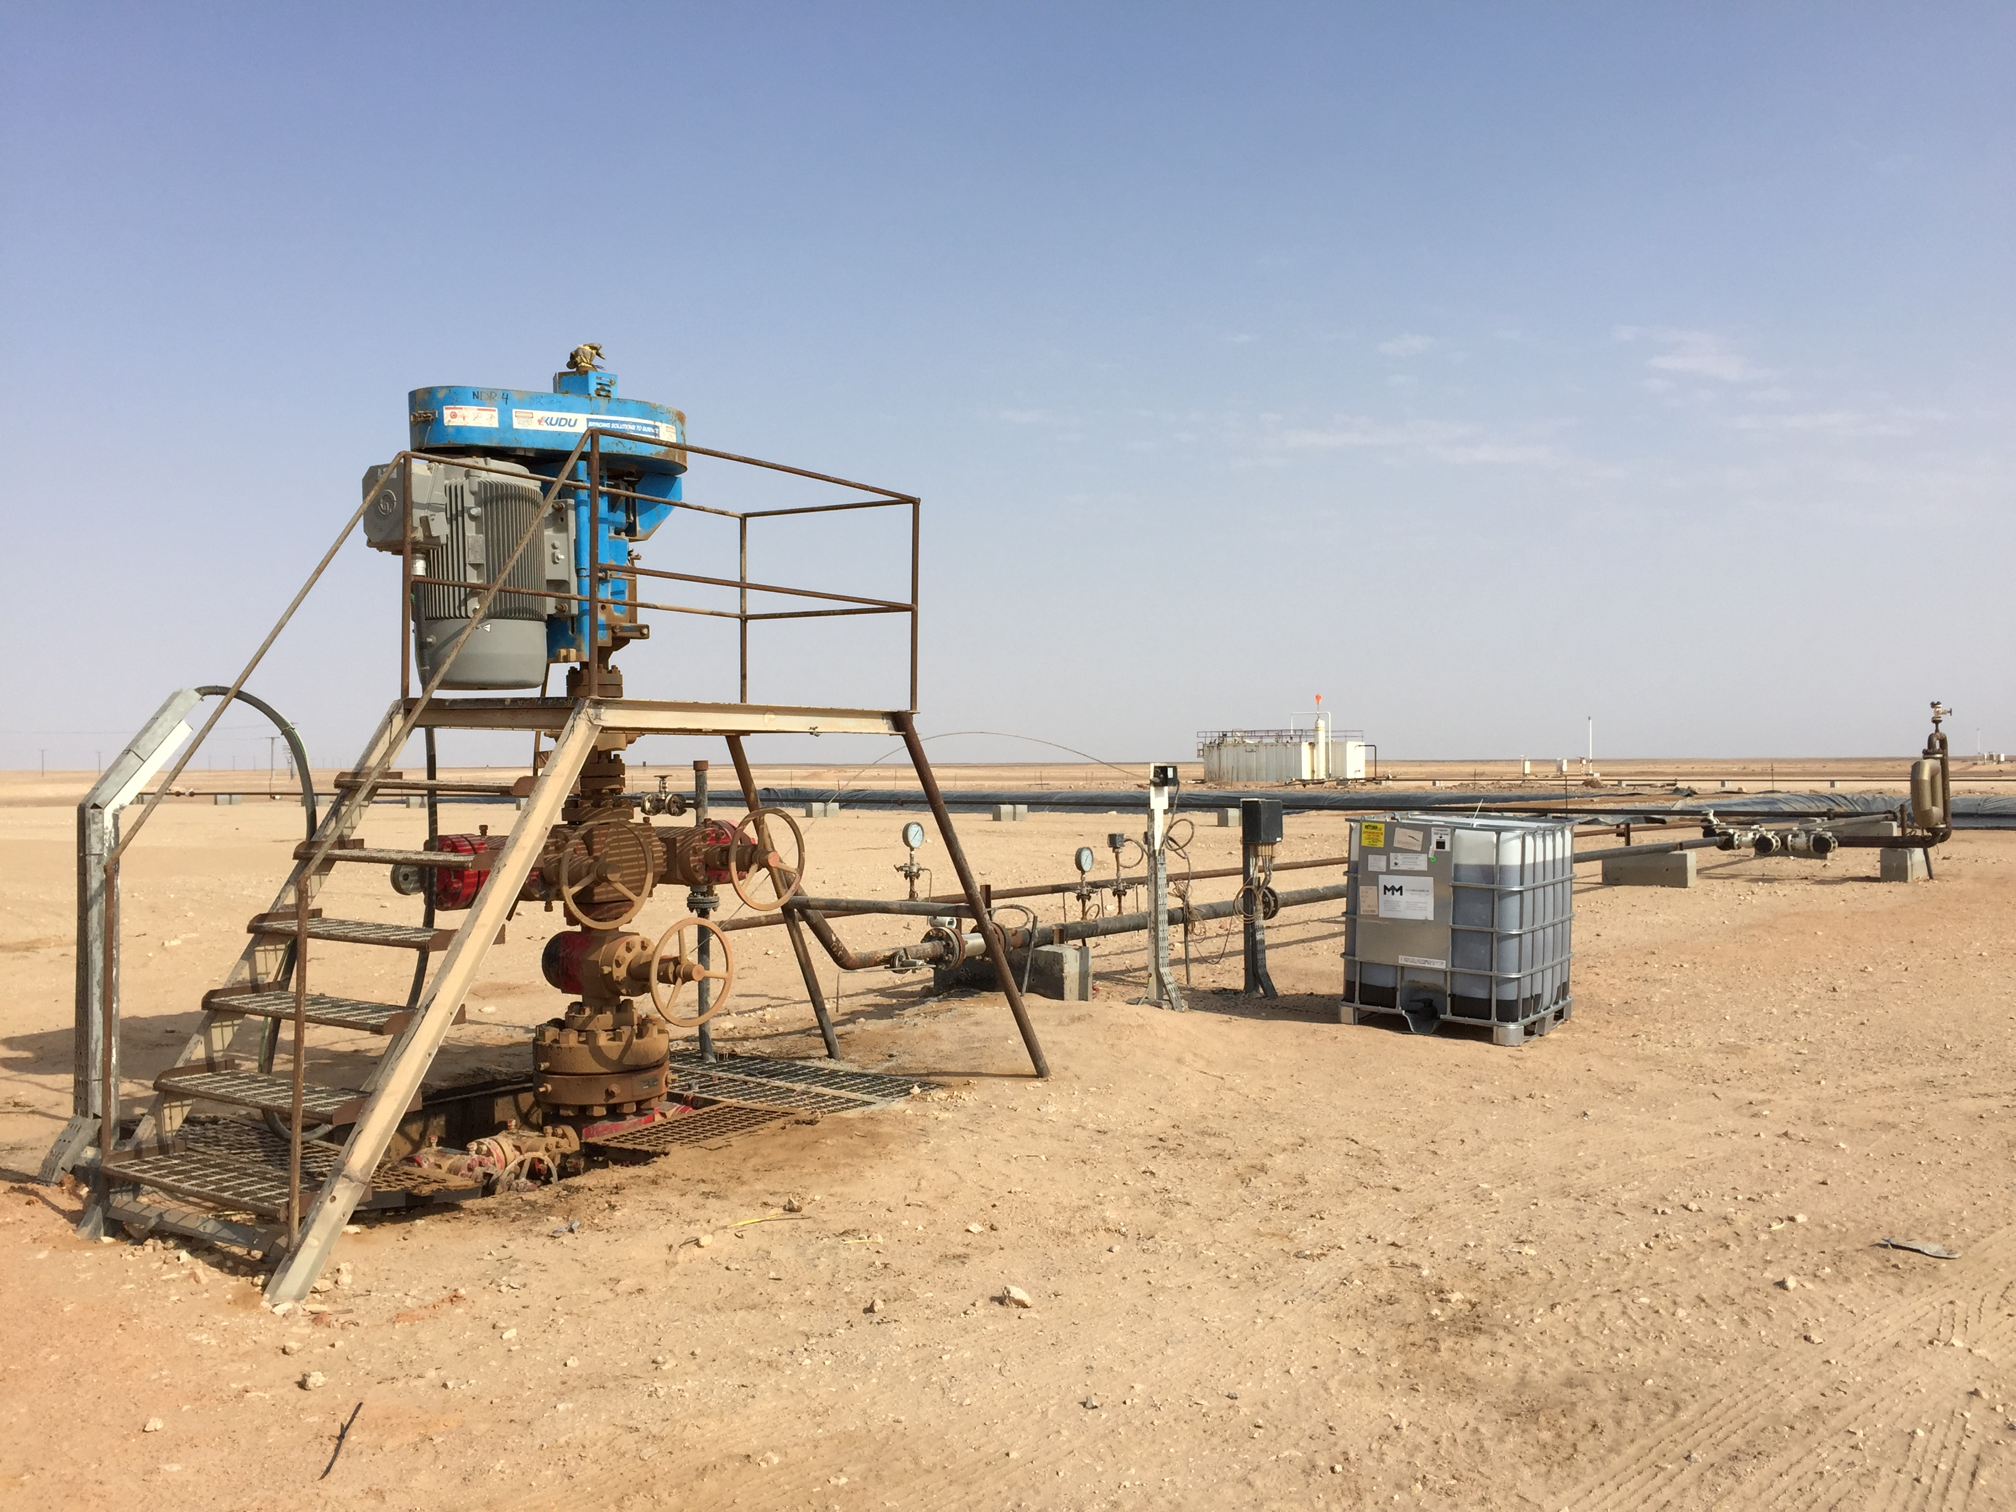
Upstream Target Market
US-Conventional
  Marginal / Stripper < 10 bopd (1-2 AZ each)
  Primary / Secondary 11 - 3,000 bopd (2-12 AZ each)
  Tertiary waterflood (4-12+ AZ each)
US-Unconventional
- Vertical (2-6 AZ each)
- Horizontal (8-100+ AZ each)
International Conventional
  - Primary / Secondary 20 - 3,000 bopd (4-12 AZ each)
  - Tertiary waterflood (4-12 AZ each)
4. Offshore
  - Secondary 250 - 3,000 bopd (4-12 AZ each)
  - Waterflood (12+ AZ each)
  (each AZ unit is 55-gallon drum or 275-gallon tote)

Slide 26
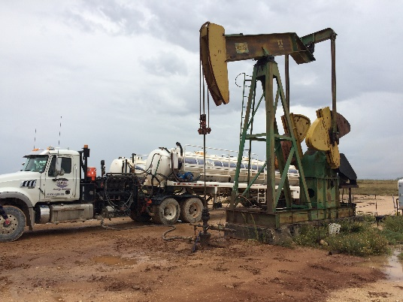
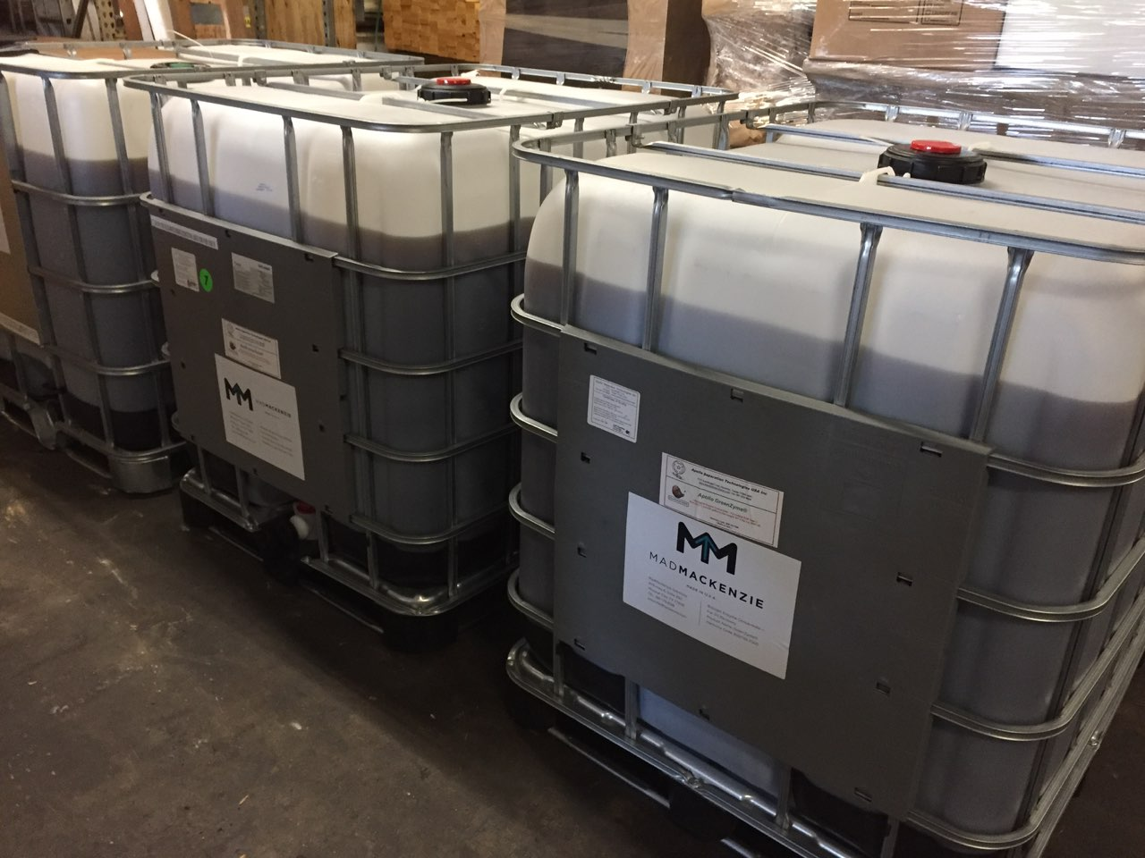
Upstream Market-Entry Results
Stripper Well Trials
  Well A: 1-bopd with 55% avg increase for 15 months post-treatment
  Well B: 1-bopd with 300% increase for first 60-days and settled in at 65%
  Well C: 3-bopd with 66% increase for first 90-days, 230 bbls incremental oil
Waterflood Application
- First wells treated, awaiting results
- First offshore project identified
Secondary Production Conventional Wells
- Well D: 18-bopd with 65% avg increase for first 65 days and currently 40%
- Well E: 80-bopd treated, 26% increase first 90-days, 1,400 bbls additional oil
- Well F: Problem well at 0-bopd, achieved 7.5-bopd avg first 90 days, 660-bbls
- Heavy oil steam flood: off-spec tank opportunity identified, working to treat emulsions and bring crude to sellable value
Unconventional Frac
  First major Permian field trial scheduled in February
  Two brownfield low psi stimulation jobs scheduled in April

Slide 27
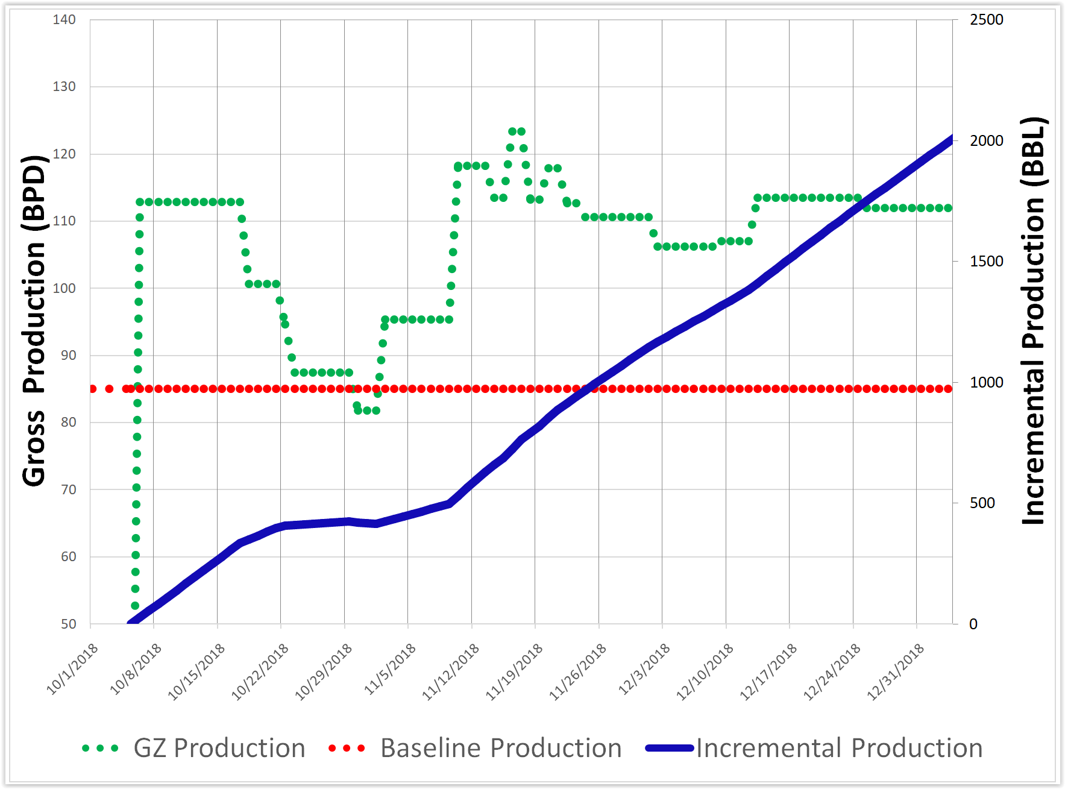
Proof of Concept – Omani Heavy-Oil Conventional
Gross production improvement
The Situation
The Result
Well IP 119 bopd, declining to 68 bopd
20% water cut
Average porosity 23% producing 16 API oil from three pay zones
Gross production post treatment has yielded over 2300-bbls incremental vol. in the first 90-days
The Treatment
Well shut-in with squeeze job of 365 bbl of water, and 4 drums (220-gal) of AlphaZyme®
27

Slide 28
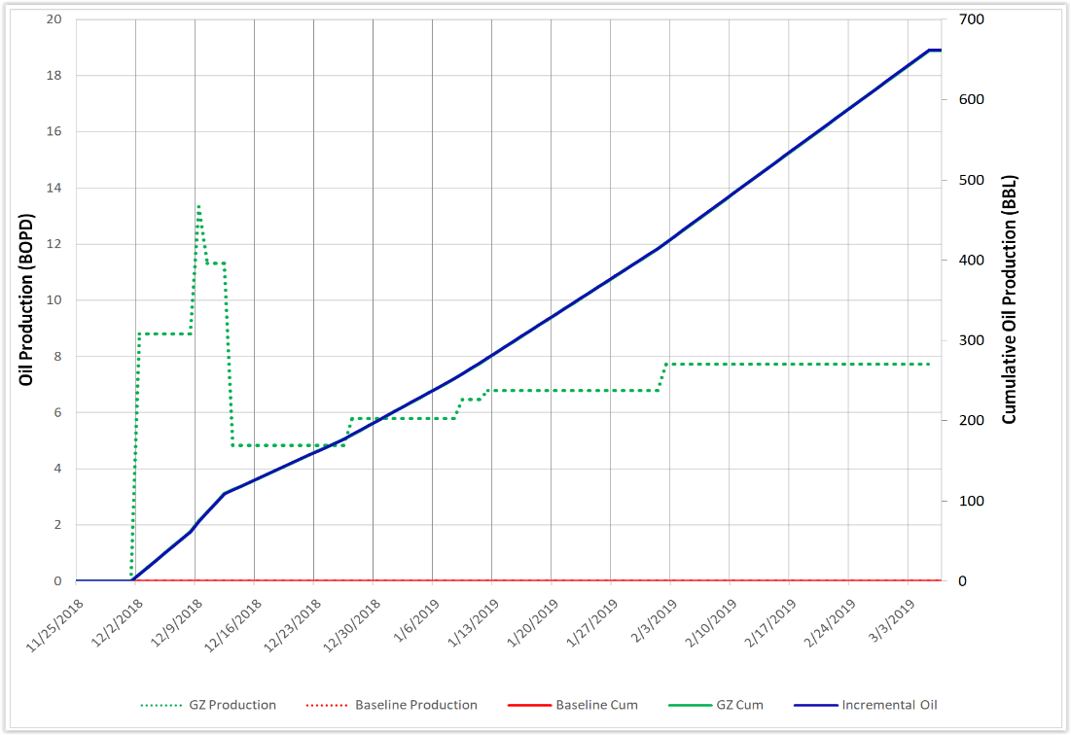
Proof of Concept – Conventional Rescue & Recover
Achieved 660 bbls incremental oil in first 90-days
The Situation
The Result
Well IP 44 bopd, experienced severe decline over first 18 months production
Well production hit 0-bopd for 100 days prior to AZ treatment
Average porosity 23% producing 21-API
No gravel-pack, sand production problem
Immediate improvement achieved, avg of 7.5-bopd first 90 days, sand prob mitigated
Yielded 660-bbls of incremental oil in first 90 days achieving positive ROI, still monitoring
The Treatment
Stimulation included Qty 4 drums (220-gal) of AlphaZyme® and 350 bbl of water
5-7 day shut-in recommended
Treated down backside, keeping costs low
Rescue operation and attempt to bring well back to life
28

Slide 29
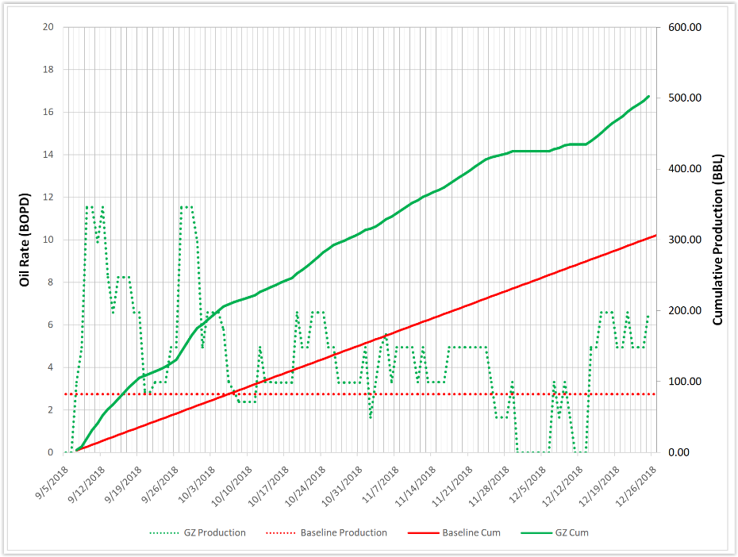
Proof of Concept – U.S. Marginal Conventional
66% production improvement avg at 90 days
The Situation
The Result
Well IP 21 bopd, declining to 3 bopd in less than 18 months
Average porosity 11% producing 41 API oil from a single pay zone
Average of 66% improvement over the first 90 days yielding 230 bbls incremental oil
The Treatment
Well treated down backside with Qty 2 drums (55-gal) of AlphaZyme® 2% KCI water and 325 bbls produced water
Well shut-in for 4 days
29

Slide 30
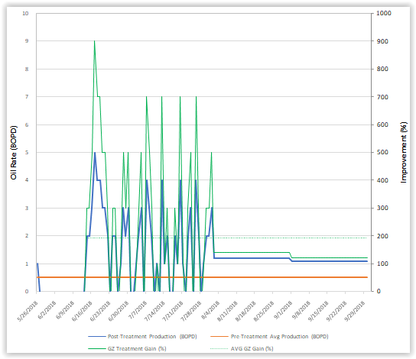
Proof of Concept – U.S. Marginal Conventional
115% production improvement avg at 100 days
The Situation
The Result
Well IP 57 bopd, declining to < 0.5 bopd
Average porosity 12% producing 32 API oil from a single pay zones
Average of 115% improvement over the first 100 days yielding 70 bbls incremental oil
Positive ROI achieved at 115 days
The Treatment
Well treated down backside with Qty 1 drums (55-gal) of AlphaZyme® and 120 bbls produced water
Well shut-in for 7 days
30

Slide 31
US-Marginal Well Success

Slide 32
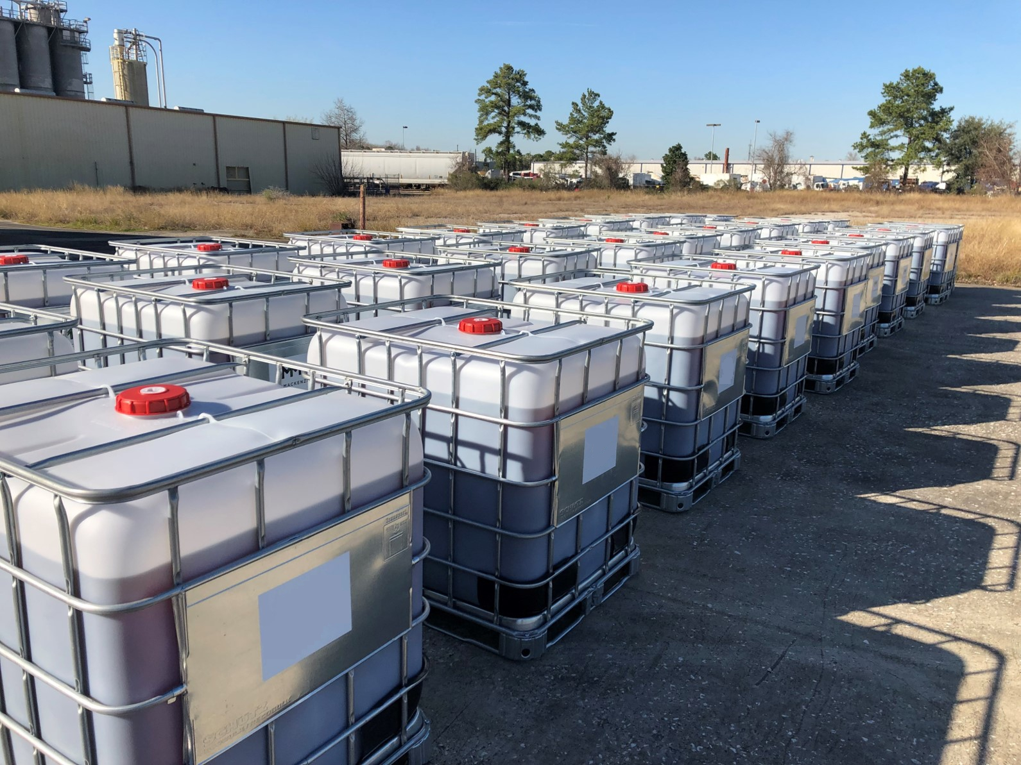
Proof of Concept – U.S. Permian Unconventional
First major unconventional field trial
The Situation
Execution
Execution of first zipper-frac in February
Trial Value of $400K
Successful indicators will include:
  Increase initial oil production
  Reduced duration of time to produce
  Oil mobility to produce at less pressure
Project planning executed
Frac job execution in Q2
The Method
AlphaZyme to mix with frac water, to interact with the most oil in the fractures
Quantity-30 totes (6,600 gal) mixed with frac water at ratio of 4-gpt (gallons per thousand)
Solution will benefit from natural shut-in duration during completions
32

Slide 33
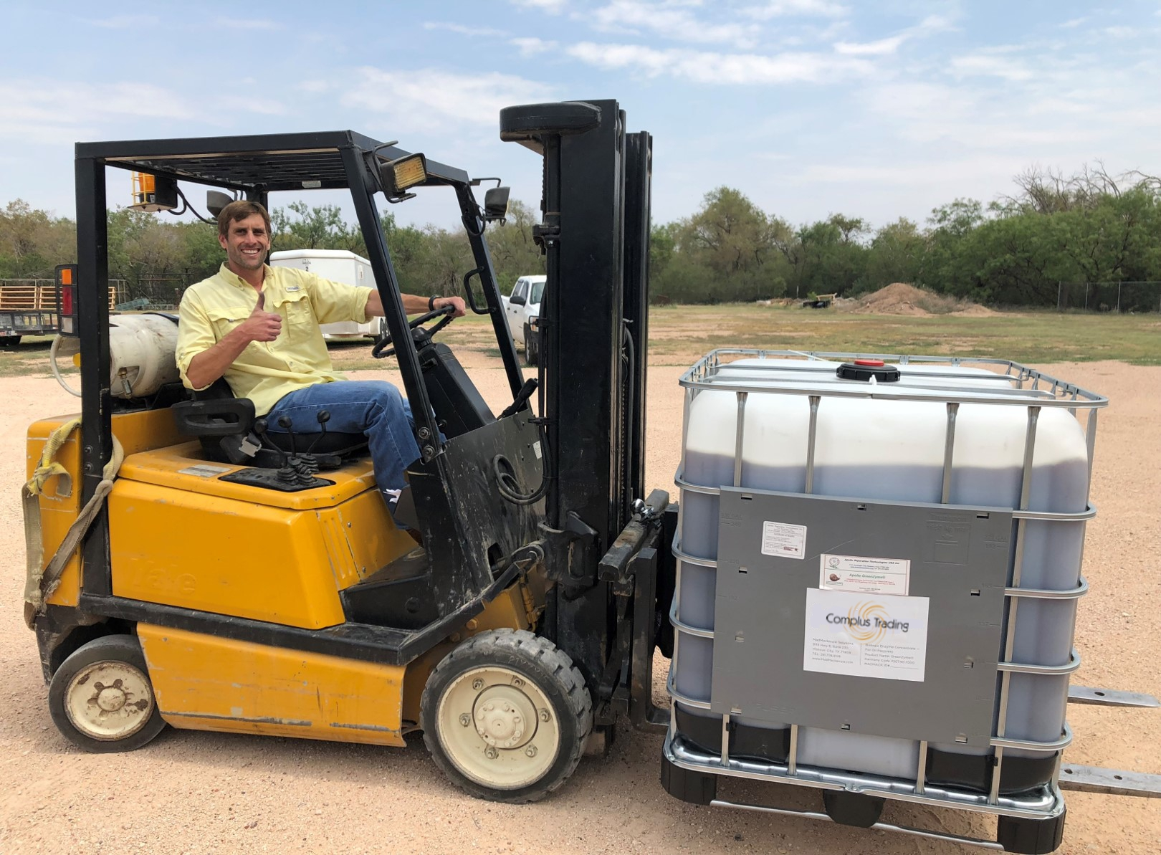
Proof of Concept – U.S. Permian Unconventional
Two well trial for unconventional brownfield stimulation trial
The Situation
Execution
Execution of Qty-2 unconv. brownfield stim
Trial to mobilize oil w/less required energy/psi
Successful indicators will include:
  Improved oil production and flow rate
  Reduced duration of time to produce
  Assist Oil mobility to produce at less psi
Product delivery in progress
Low psi stim job scheduled to execute in Q3
The Method
AlphaZyme injected with water at low psi to stimulate residual oil in the fractures
Qty-2 drums (55-gal each) per well, mixed with water at ratio of 4-gpt (gallons per thousand)
Solution will benefit oil migration thru proppant network and small closures with less required energy/psi to produce
33

Slide 34
Impacting on Unconventional Resources
Mixed with frac water, AlphaZyme will treat an unconventional horizonal during a multi-stage frac process.
Implemented during the frac process, AlphaZyme will maximize its opportunity to interact with hydrocarbons.
As each stage is completed AlphaZyme will benefit from a beneficial soak period, optimizing its impact potential.
When production begins the following improvements to oil mobility are achieved:
  Oil-released from the surface of rock
  Reduced IFT & capillary pressures
  Improved contact angle
  Improved relative-permeability
  Maximize recovery of OOIP
  Reduced impact to environment
Notes:
Now lets talk about future possibilities – Unconventional wells. How we introduce the product could differ but can have a similar maybe even better benefits compared to the increased production we are seeing on sand producing wells. We would like to partner up with your unconventional team in the future.

Slide 35
Market Potential
Upstream Oil Recovery
Drilling
  Cuttings
  Emulsions
  Soil Remediation
Downstream
  - Separation
  - Flow assurance
Environmental / Remediation
  Tanker / FSO
  Railcar
  Trucking
  Soil

Slide 36
Upstream Sales Strategy
Direct Sales to Operator
  Well by well
  Field based
CSS – Challenge-Specific Solutions
  Recover More OOIP
  Heavy oil
  Paraffin / Asphaltene
  Application specific “copy-cat” targets
Strategic Partners
  Industry-specific
  Regionally focused
  Application specific
Notes:
3 Important factors we have learned need to bee considered when introducing of AlphaZyme product into a field / wells.

Slide 37
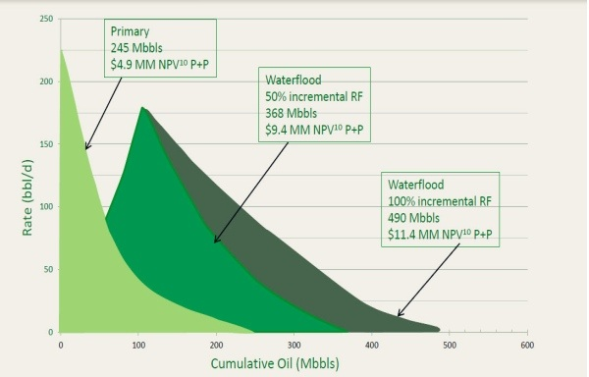
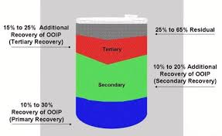
Recover More OOIP Opportunity
Challenge
Recover more OOIP than current industry methods
Extend life-of-well with consistent production rates
Reduce footprint of nasty production chemicals
Cleanly recover oil
Supply clean product downstream
Upstream Recovery: Target Market
US - Conventional Assets
  Marginal / Stripper Wells
  Secondary Production
  Tertiary Production
US - Unconventional Assets
  Initial frac, new completions
  Re-frac market, continued production
  Clean-frac to reduce environmental footprint
International
  Middle East: Oman Qatar, Kuwait & UAE
  North Sea
  Canada, Mexico, Africa
Offshore
  North Sea, GOM & West Africa
Product Features & Benefits
Easy to use, low risk to implement
Environmentally-friendly oil-releasing enzyme
True catalyst, performs its function repetitively over-time
Non-consumable and reusable oil-releasing agent
No special equip needed & does not damage equip
Inert water-soluble protein, plays well with chemistry
Value to Client
Low cost, low risk and easy to use
Efficiently recovers more oil and alleviates blockages
Operation consistently achieves positive ROI
Operation yields long-term positive effects to life of well
Higher value crude at point of sale, clean crude

Slide 38
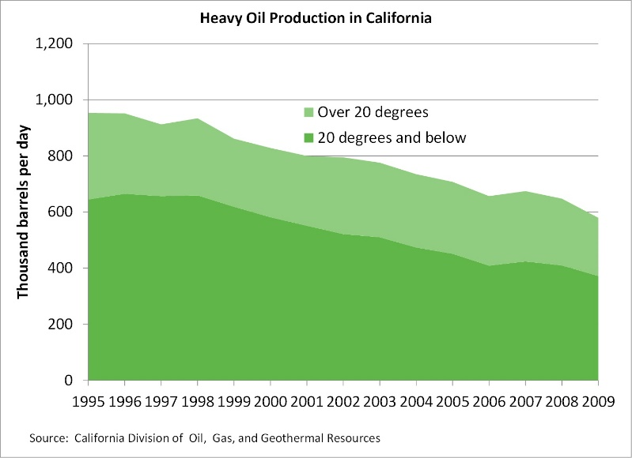
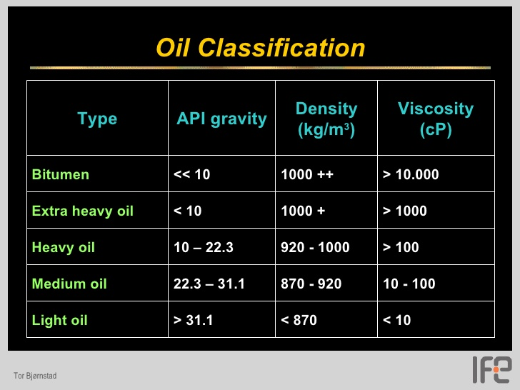
Heavy Oil Opportunity
Challenge
High viscosity, low gravity API
Strong adhesion properties, low mobility
High sand production
Asphaltene content
Emulsions, formation of water-in-oil
Current Targets
Middle East
  Pipeline Supply Co. (Oman)
  Saudi Drill Co. (Saudi Arabia)
  LIWA (UAE)
California
  RL Environmental (CVX & CRC)
Canada
  Progressive Fuels Limited
Alaska
Edwards Country, TX
Mexico
Our Solution with AZ
Release oil’s adhesion to substrate
Micro-oil droplets improve relative-permeability
Relieve formation blockages; paraffin, asphaltene
Improve oil mobility in-formation
Reduced sand production
Value to Client
Low cost OpEx method to Recover More OOIP
Improvements to reservoir flow conditions
Less chemical & less downtime = cost savings
Aid to separation and downstream processing
Benefit of environmentally-friendly solution
Notes:
Jim Will talk about heavy oil

Slide 39
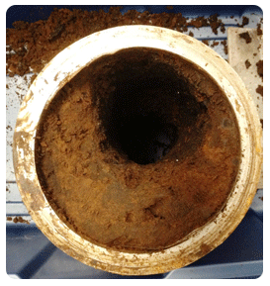
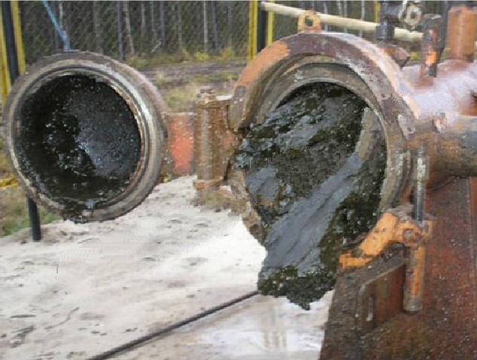
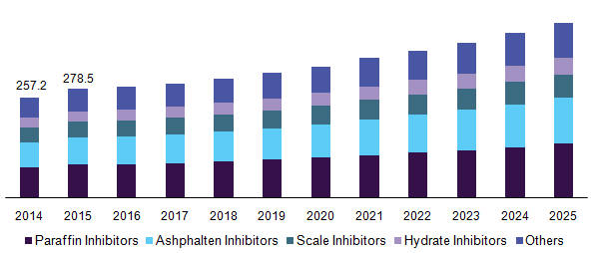
Paraffin Opportunity
Challenge
Hydrocarbon compound that precipitates on production components resulting from change in temp & psi
Heavy wax substance that builds up on oil in a honeycomb-like structure, attached to oil
Strong adhesion properties, low mobility with a strong tendency to create severe blockages and halt flow
Current industry solution: Lots & Lots of nasty chemicals and/or heat
Our Solution with AZ
AZ is not an inhibitor, does not solve paraffin
Releases & displaces oil to mobilize paraffin
Relieves formation blockages of mild to severe paraffin
Improve oil & paraffin mobility
U.S. Onshore Crude: Chemical Revenue by Product (USD Million)
Value to Client
Effective paraffin mobilization and blockage removal
Recover More OOIP by releasing trapped hydrocarbons
Improvements to equipment degradation
Less chem, less opex & less downtime = cost savings
Benefit of environmentally-friendly solution
US Avg yearly paraffin spend is $80-150M
Notes:
Piggy back on the Rod thing

Slide 40
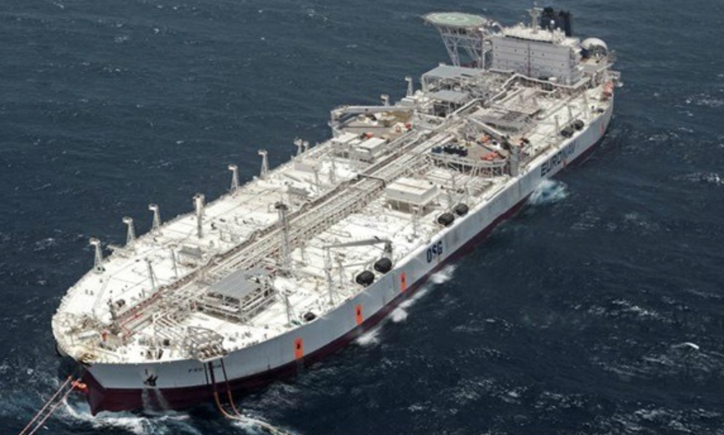
FSO Tanker Cleaning Application (Pilot)
Challenge
Tanks with existing water and hydrocarbon sludge
Tanks have structural members making it difficult to clean with pressure-washers
Current industry solution: Pressure-wash and remove hydrocarbon laden sludge manually. Costly for transporting hydrocarbon waste – nasty mess.
Our Solution with AZ
Utilize AZ in Firehose Induction System to soak walls of tank
AZ and water soak to the bottom of tank - releases and displaces oil from sludge
Skim-off and recover incremental oil for refinery
Re-circulate AZ water to next tank
Value to Client
Effective cleaning and removal of hydrocarbons
Recover more oil by releasing trapped hydrocarbons
No equipment or tank degradation
No hydrocarbons in sludge = cost savings for disposal
Benefit of environmentally-friendly solution = cost savings for operations near shore
Typical FSO
Notes:
Opportunity via strategic partner IOC and relationship/contract with Pemex

Slide 41
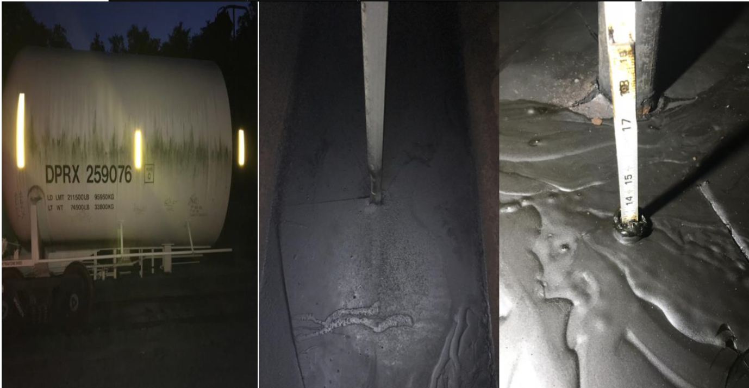
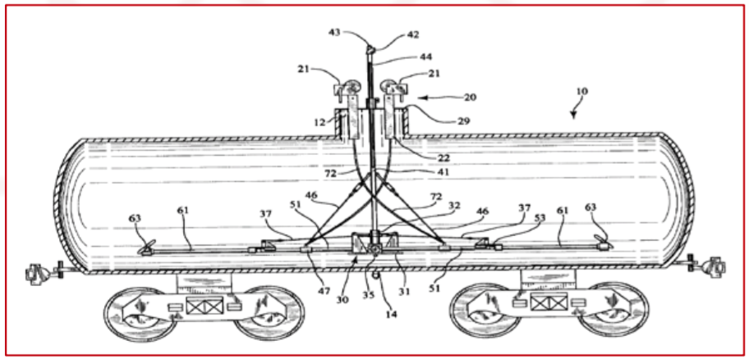
Railcar Tanker Crude Cleaning Application (Pilot)
Challenge
Railcar tanker with heavy hydrocarbon sludge
Current industry solution: Pressure-wash/steam and scrape to clean hydrocarbon/paraffin. Manually shovel hydrocarbon laden sludge thru BOV or suck it out of heel. Hazardous for personnel and costly for transporting / disposal of hydrocarbon waste – nasty mess.
Our Solution with AZ
Add AZ to hot oiler with existing water
AZ / water heated 200 F injected Railcar for 1 hour – releases and displaces oil from sludge
Recover incremental oil for refinery
Re-capture AZ water for next railcar tanker
Remove clean hydrocarbon-free waste
Value to Client
Effective cleaning and removal of hydrocarbons
Recover more oil by releasing trapped hydrocarbons
No equipment or tank degradation / improved operations
No hydrocarbons in sludge = cost savings for disposal
Benefit of environmentally-friendly solution = cost savings for on-site operations
Typical Tanker Railcar
Notes:
Crude Railcar Tankers – Rail Industry utilizes 3rd party service companies for cleaning opportunity via PFL (strategic partner for rail) and their industry relationships/contracts

Slide 42
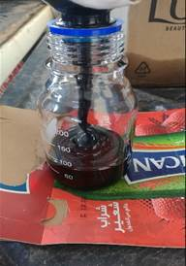
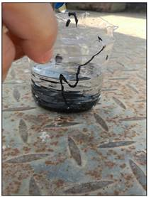
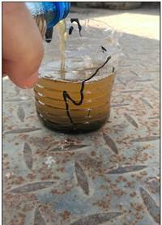
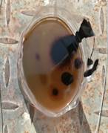
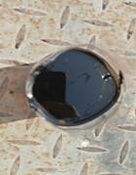
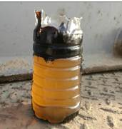
API-16 Oil
AlphaZyme D300® Client Field Test
Service Hand Field Test, Oman
API-16 oil poured into glass container
Cut plastic bottle received API-16 oil
Water only added, no reaction after period of time
AlphaZyme product added to water
AZ added at approximately 10% concentration and allowed to work
After 30-45 minutes
Released oil is now visible at surface of water
After 3-hours
Significant portion of oil is mobilized to water surface
After 5-hours
AZ has released more than 90% oil from bottom and side walls, without agitation or heat
Notes:
Main features & benefits of AZ

Slide 43
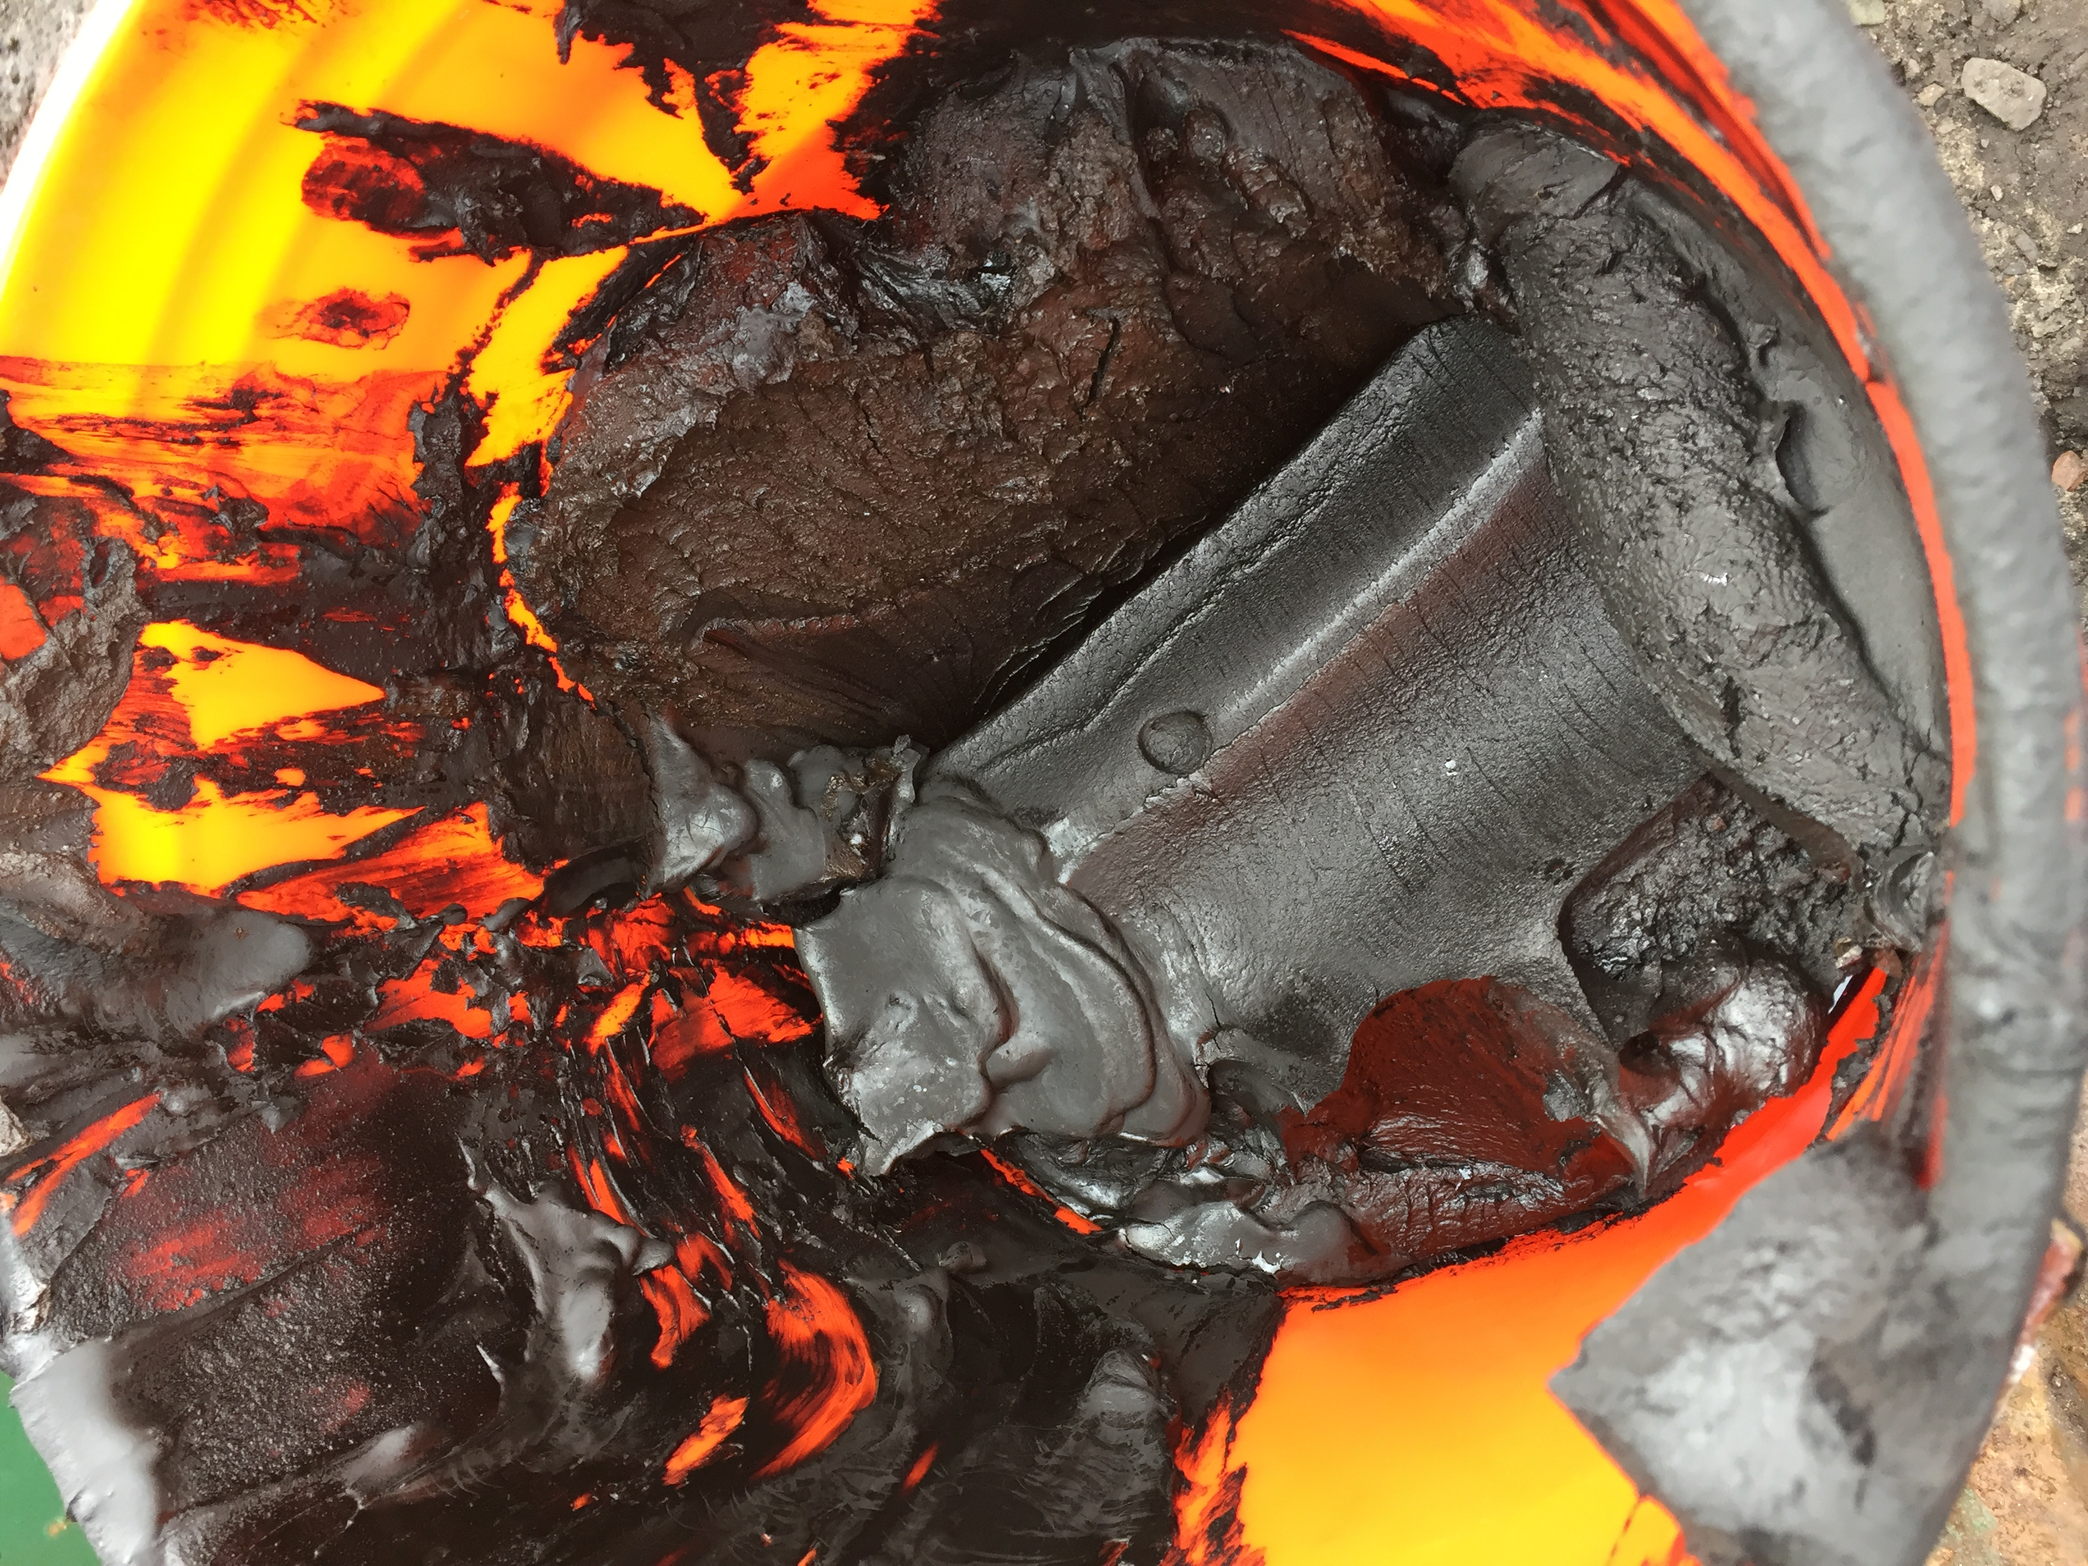
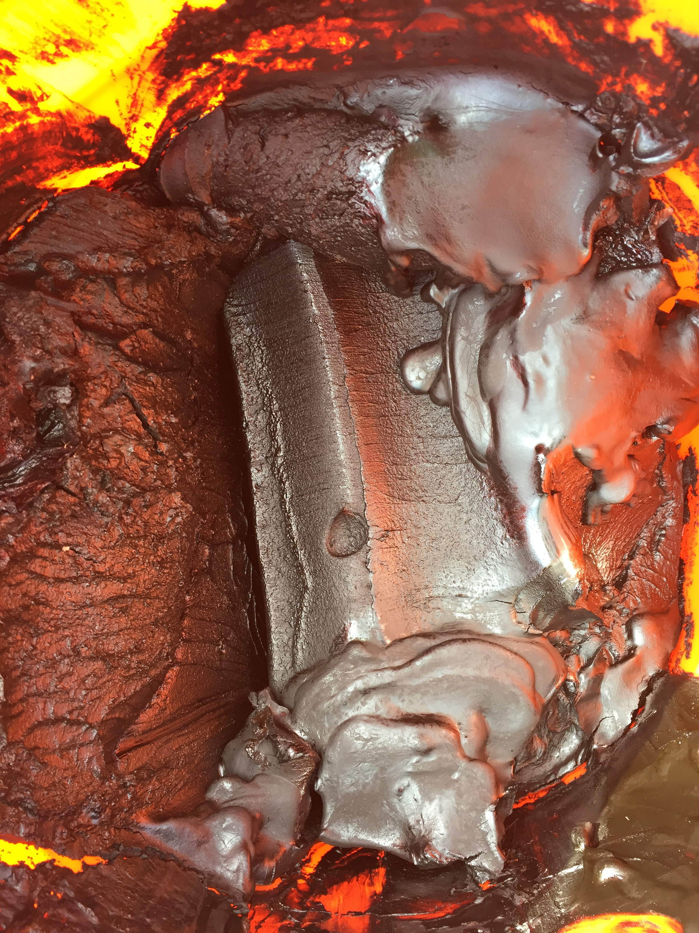
Untreated Crude Sludge from Tanker Railcar Heel

Slide 44
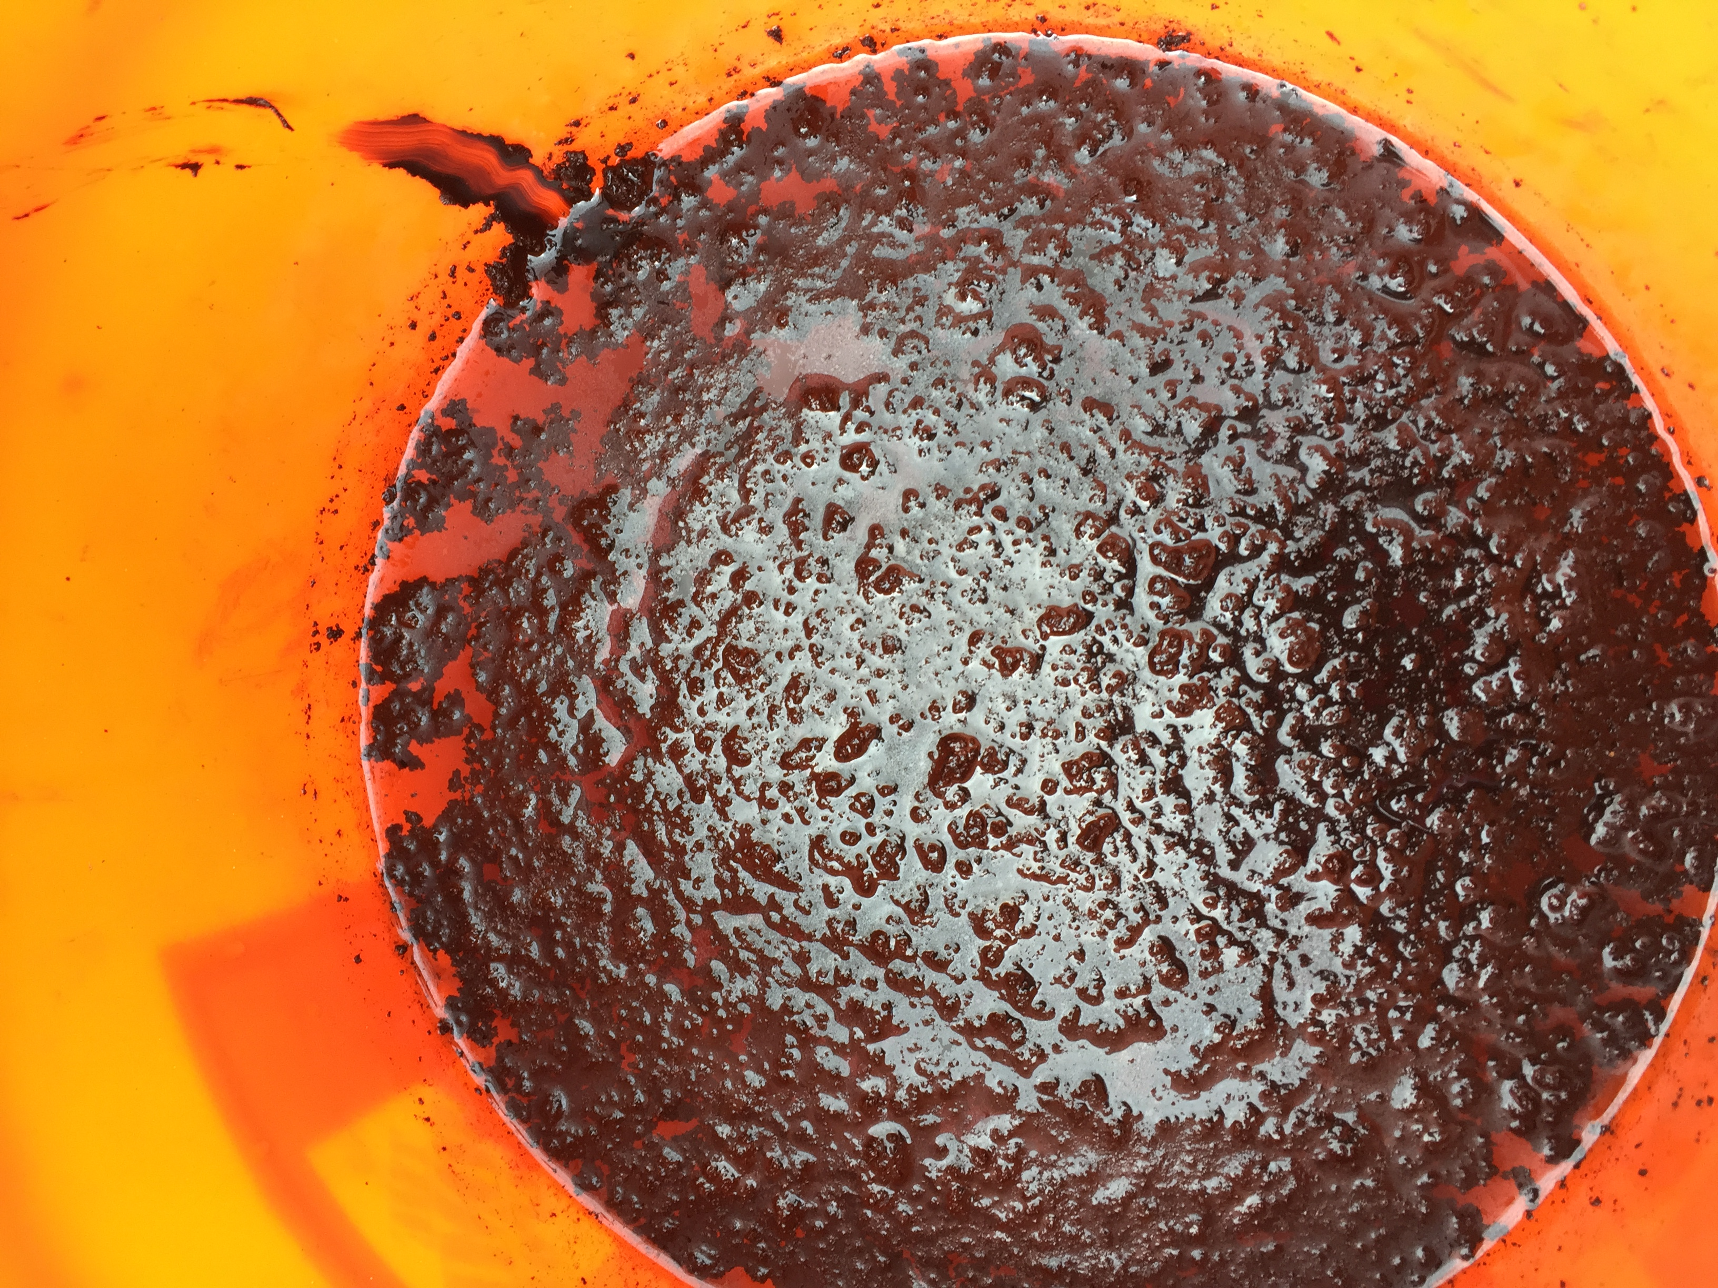
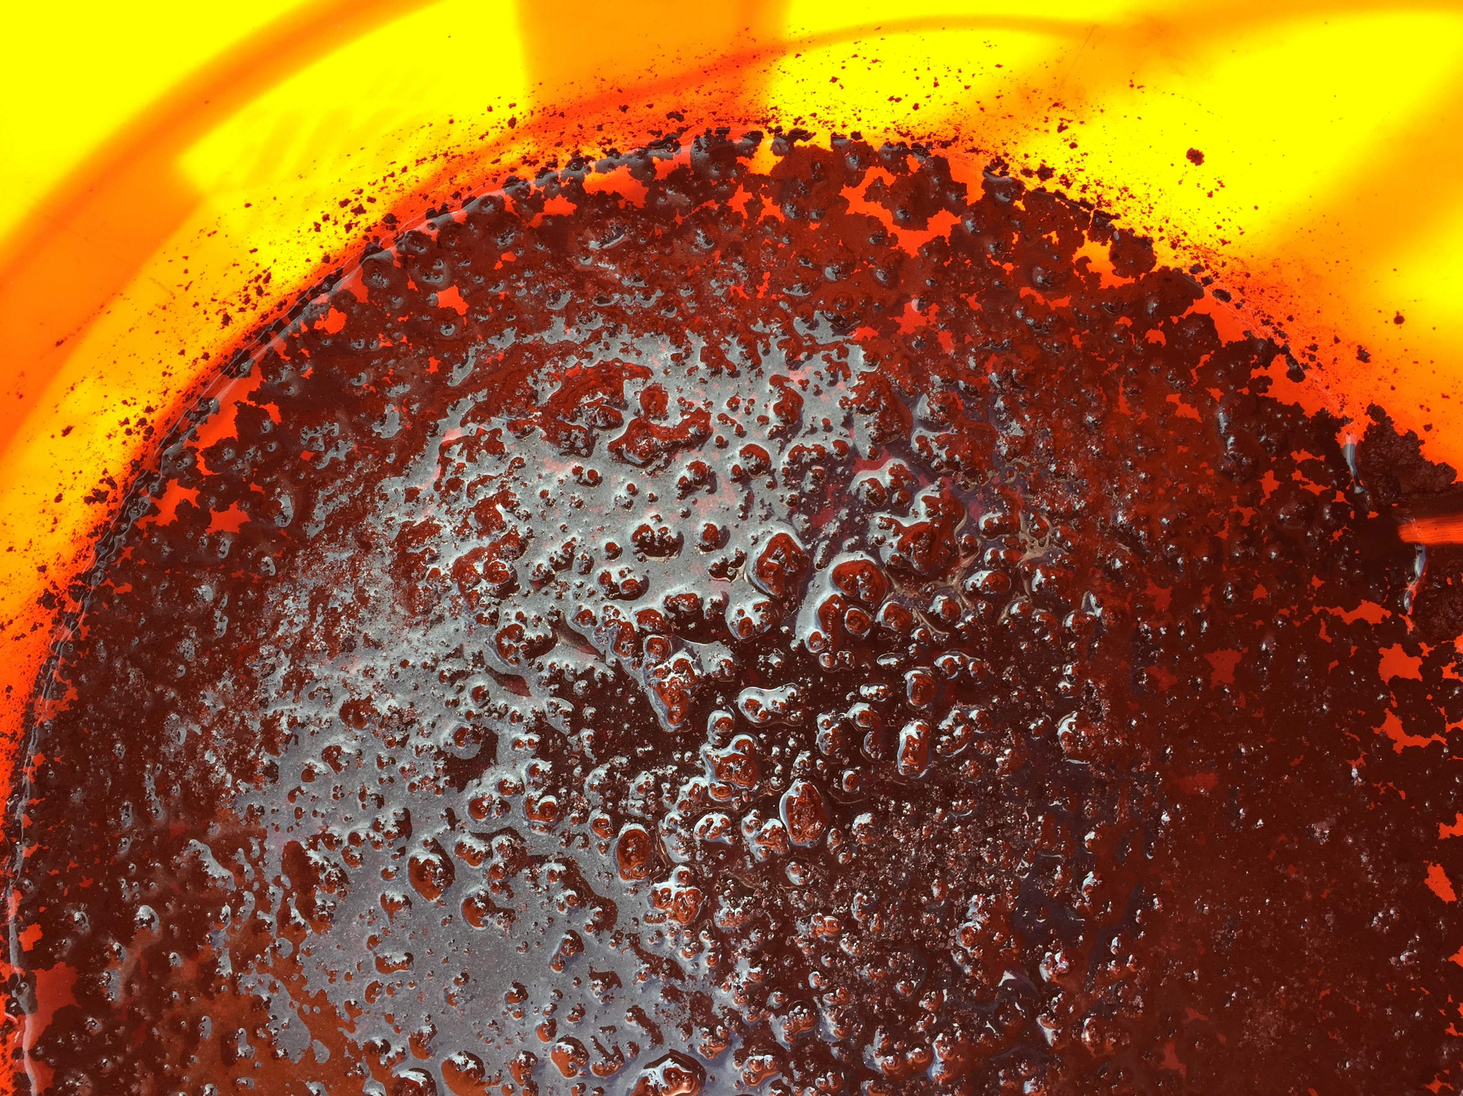
Hot Crude Sludge from Tanker Railcar Heel – Treated with AlphaZyme D300® (Test)

Slide 45
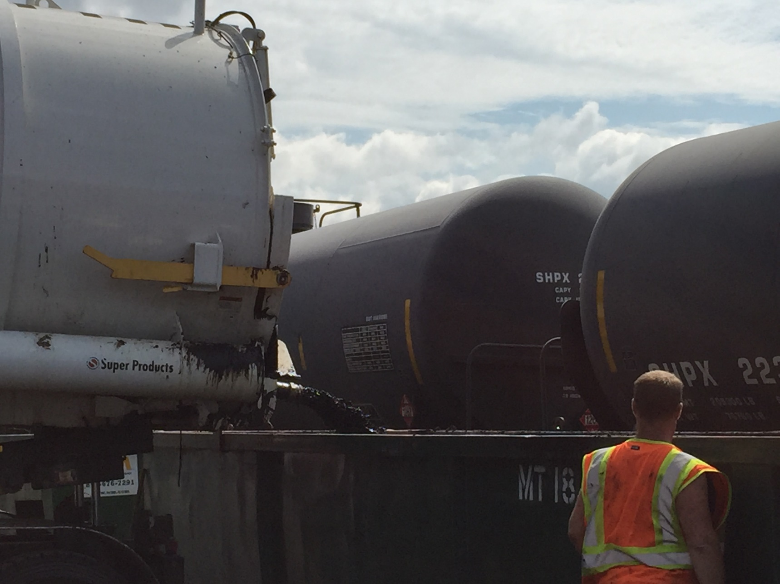
AlphaZyme® Treated Crude Sludge Mobility

Slide 46
Recover More OOIP
AZ is the industry’s first non-consumable and re-usable downhole recovery solution, proven to Recover More OOIP
Improving Oil Migration
Summary of
AZ’s impact to IFT and contact angle aid oil’s mobility to travel through formation more efficiently, requiring less pressure drive
AlphaZyme®
Benefits
Heavy Oil Production
Mobilize heavy oil more efficiently than traditional chems and does not impact the hydrocarbon chain or cause emulsions
Paraffin Mitigation
AZ is not a solvent, however as a result of its behavior AZ is able alleviate blockages to help mobilize paraffin with the residual oils it encounters
Notes:
Main features & benefits of AZ

Slide 47
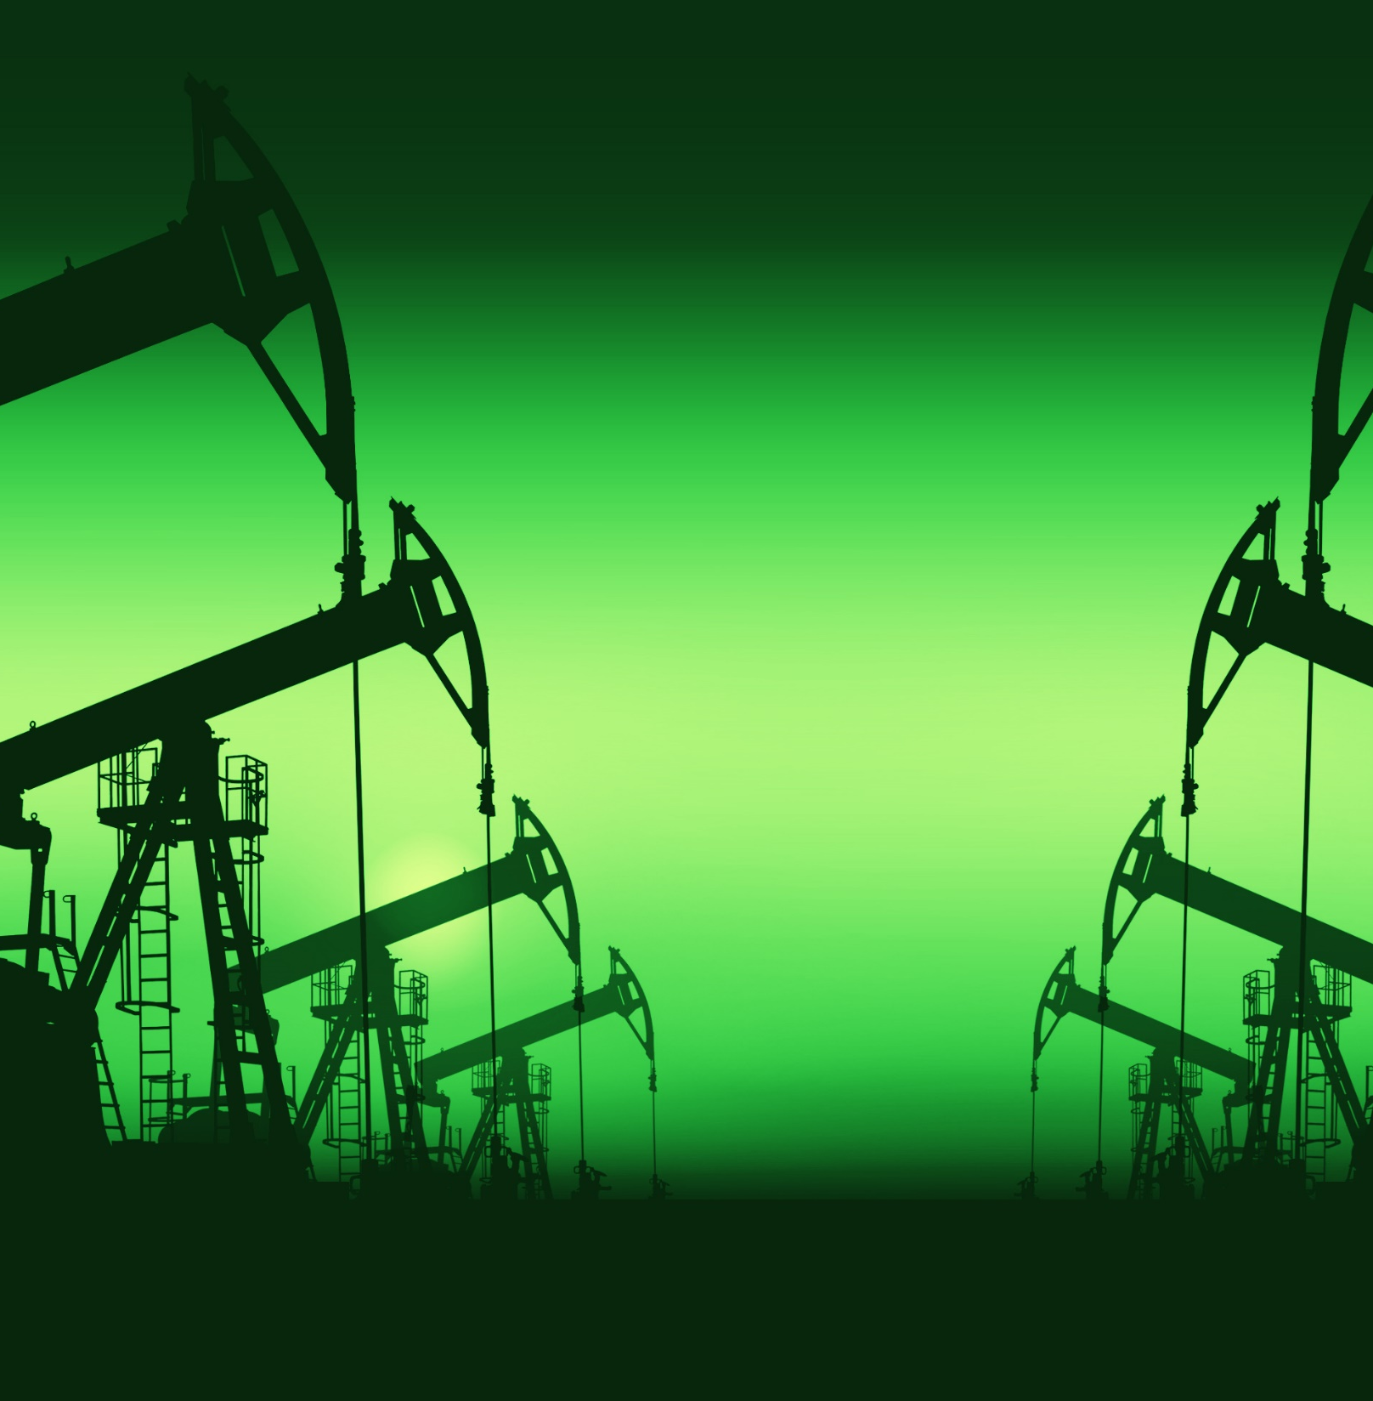
Thank you
For your time.
Please contact us for more information and learn if AlphaZyme D300 is the right choice for your oil wells.
Complus Trading North America LLC
5151 Katy Freeway, Suite 140, Houston, TX 77007
info@complustrading.com
Office: +1 830.200.5119

